Slide 1


Parallel simulations for fast-moving landslides, Part II
Federico Gatti
MOX-Modelling and Scientific Computing, Applied Mathematics Department, Politecnico di Milano

Slide 2

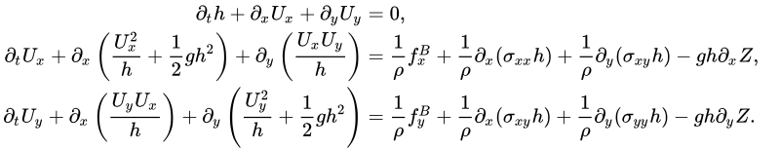




Model equations: one-phase model
In case of "gentle" slope, ​averaging is in the vertical direction​,
State variables,
$$h$$
Superficial free-surface
Free Surface
$$U_{x}, U_{y}$$
Horizontal mass fluxes
$$Z$$
Orography profile
h
"Dry" Region
Depth-integrated visco-plastic Bingham stress model,
Voellmy rheology,
Z
z
y
"Wet" Region
x
We focus on the study of landslides runout for fast landslides
Conservation law of the form, in a moving domain $Ω_{w}$
[Quecedo M, Pastor M, Herreros MI, Fernández Merodo JA. Numerical modelling of the propagation of fast landslides using the finite element method. International Journal for Numerical Methods in Engineering 2004; 59(6): 755-794]

Slide 3
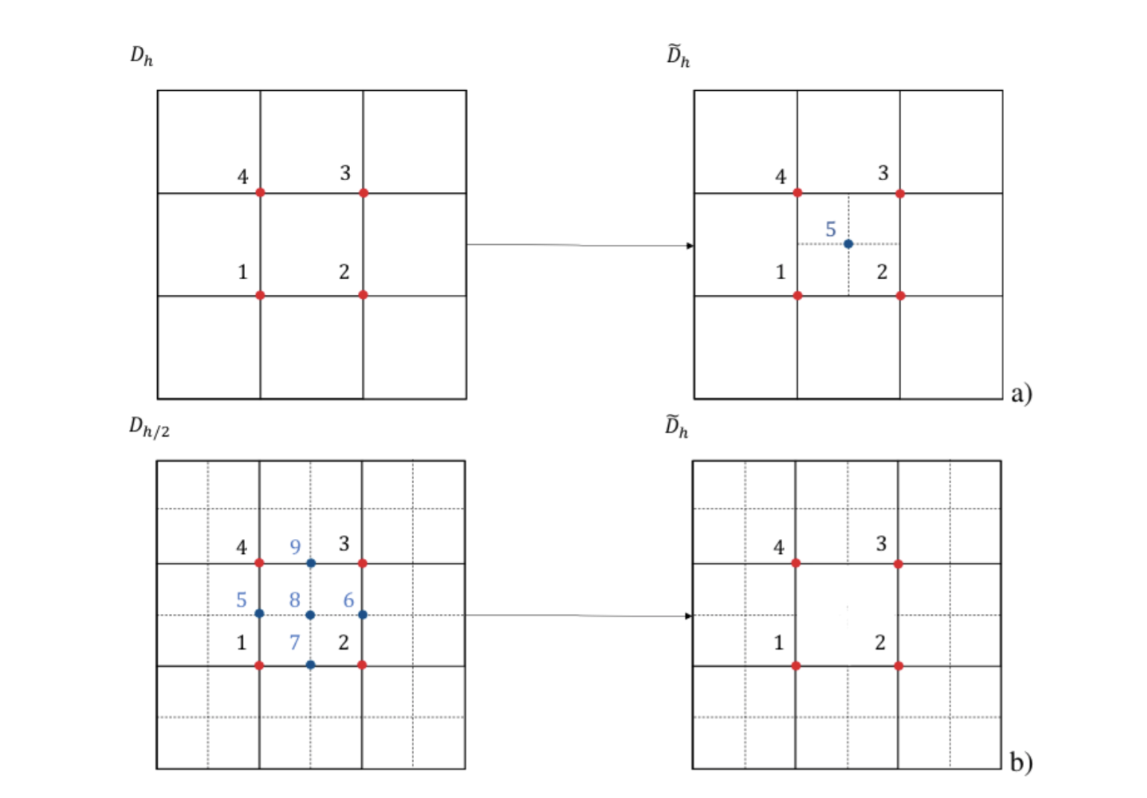
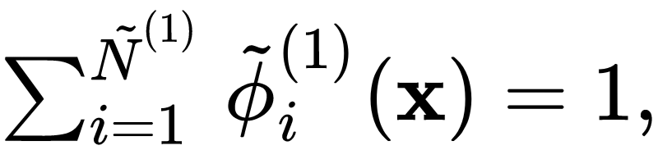
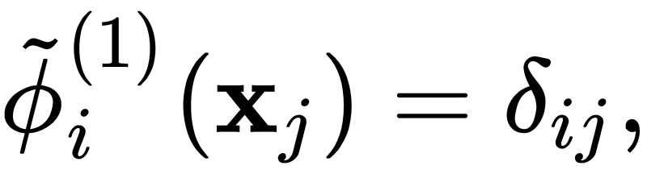
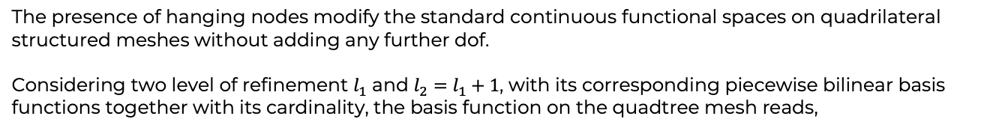
Discrete spaces on quadtree meshes
The presence of hanging nodes modify the standard continuous functional spaces on quadrilateral structured meshes without adding any further dof.
Considering two level of refinement $l_{1}$ and $l_{2}=l_{1}+1$, with its corresponding piecewise bilinear basis functions together with its cardinality, the basis function on the quadtree mesh reads,
The weights are determined by,
Partition of unity property,
Lagrangian property,
[Burstedde C,Wilcox LC, Ghattas O. p4est: Scalable algorithms for parallel adaptive mesh refinement on forests of octrees. SIAM Journal on Scientific Computing 2011; 33(3): 1103–1133.]

Slide 4
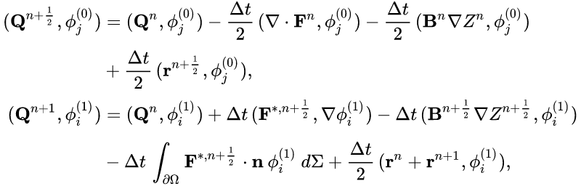
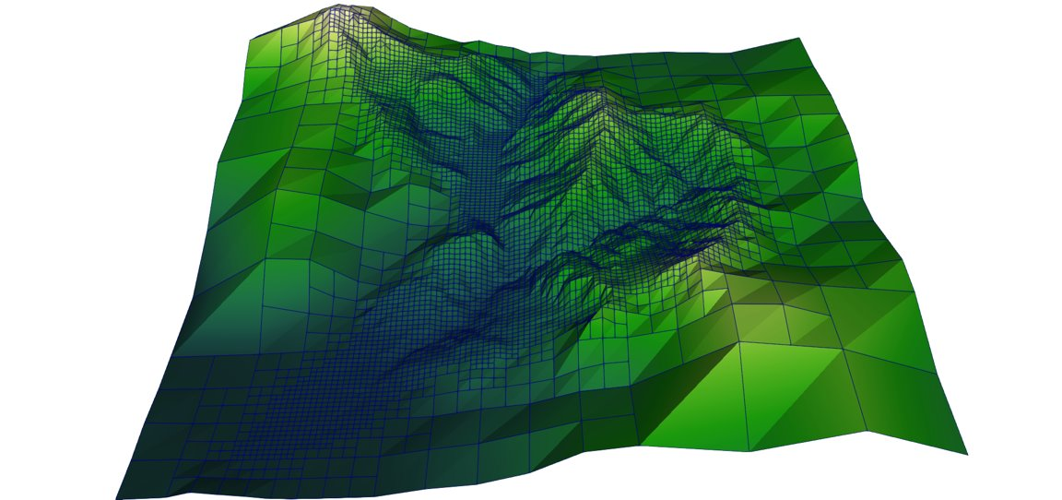
TG2-PC discretization on quadtree meshes
We employ a two step second order Taylor-Galerkin scheme (TG2) on quadtree meshes with a Zalesak’s flux correction term to compute the numerical fluxes in the second step of the method, the non-conservative contributions are computed with the Path-Conservative method (PC),
$φ_{j}^{\left(0\right)},{\tilde{φ}}_{j}^{(1)}$ define the set of piece-wise constant and bilinear functions respectively on the quadtree mesh,
$F^{∗, n+\frac{1}{2}}$ is the numerical transport flux written according to the Zalesak ‘s flux correction strategy,
An issue is the necessity to have an efficient numerical framework → TG2 + mass lumping
[Quecedo, M., & Pastor, M. (2002). A reappraisal of Taylor-Galerkin algorithm for drying-wetting areas in shallow water computations. International Journal for Numerical Methods in Fluids. ]
[Zalesak, S.T. (1979). Fully multidimensional flux-corrected transport algorithms for fluids. Journal of computational physics, 31(3): 335-431. ]
[Zienkiewicz, O. C., Morgan, K., & Morgan, K. (2006). Finite elements and approximation. Courier Corporation.

Slide 5

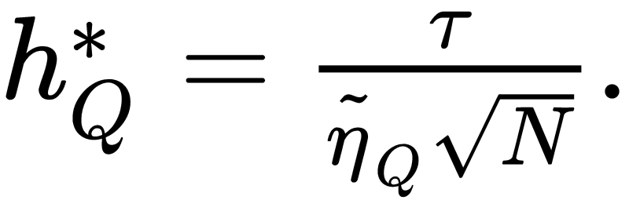
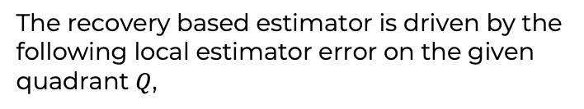
Space-time adaptivity
Quadtree meshes enable easy coarsening and refinement operations. We use an isotropic data structure.
The two adaptation procedures are carried out indipendently and they both follow the idea of the recovery based estimator.
To prevent smearing of the wet-dry interface we implement a Lagrangian interface prediction startegy
The recovery based estimator is driven by the following local estimator error on the given quadrant $Q$,
Exploiting the equidistribution principle together with the invariance of the local scaled estimator we get,
[Porta, G.M., Perotto, S., & Ballio, F. (2012). A space.time adaptation scheme for unsteady shallow water problems. Mathematics and Computer in Simulation. ]

Slide 6
Numerical results
We test the implementation in a wet-dry inviscid dam-break problem, we note that at the end of the simulation we reach a number of $6.8⋅{10}^{6}$ elements.
[Gatti, F., Fois, M., de Falco, C., Perotto S, Formaggia L.. (2022). Parallel simulations for fast-moving landslides: space-time mesh adaptation and sharp tracking of the wetting front. Submitted: International Journal for Numerical Methods in Fluids.]

Slide 7

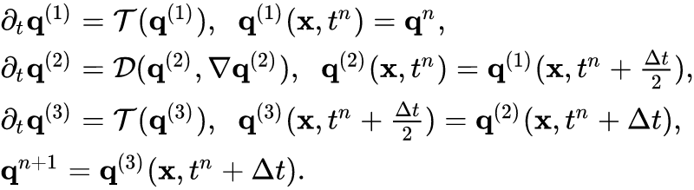
Efficient time stepping
The stiffness of the diffusion and source term can be overcome using a time integration method able to enlarge the absolute stability region along the real axis. We can combine a local implicit modification of the TG2 scheme with the Implicit-Explicit Runge-Kutta-Chebyshev (IMEX-RKC), respectively to solve the advection and diffusion-reaction problems.
The two schemes are combined using a well-balanced Strang splitting method which introduces a second order consistency error which is in agreement with the overall numerical framework. Considering the space-time continuous transport and diffusion-reaction operator, and
[Gatti, F., de Falco, C., Perotto S, Formaggia L.. (2022). A positivity-preserving well-balanced numerical scheme for the simulation of fast landslides with efficient time stepping. In preparation: Applied Mathematics and Computation.]

Slide 8
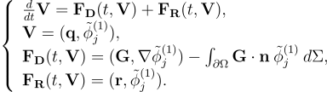
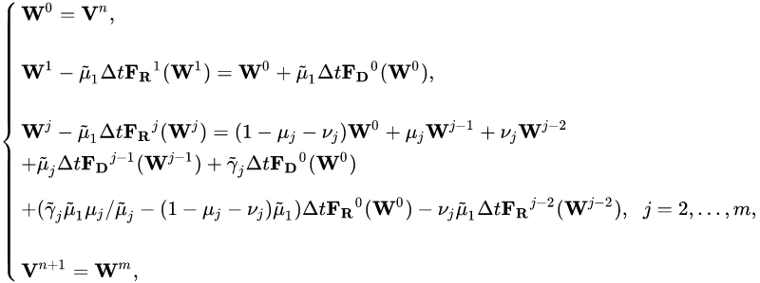

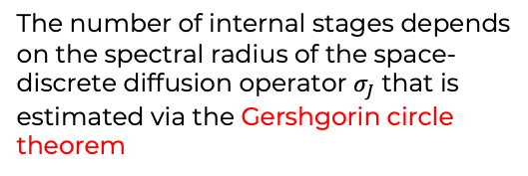
Efficient time stepping
Considering proper coefficients as described in the reference paper, it is possible to build a second order time integration scheme with a variable number of internal stages.
The splitting scheme together with the IMEX-RKC method ensures data locality which is a key request for the performances of a parallel implementation
The number of internal stages depends on the spectral radius of the space-discrete diffusion operator $σ_{J}$ that is estimated via the Gershgorin circle theorem
[Verwer, J. G., & Sommeijer, B. P. (2004). An Implicit-Explicit Runge--Kutta--Chebyshev Scheme for Diffusion-Reaction Equations. SIAM Journal on Scientific Computing, 25(5), 1824-1835.]

Slide 9
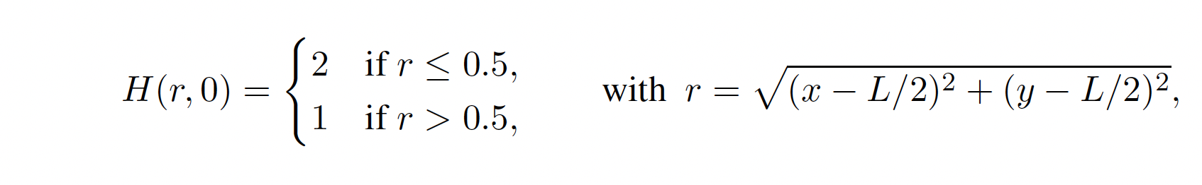
Numerical tests
We provide a reliability test, a viscous dam-break problem with Newtonian rheology where we have the propagation of two viscous shock waves, $ρ=1 kg/m^{3}$, $μ=0.05 Pa s, T=0.3 s,L=5 m.$The reference solution is computed using a level of refinement $l=11$, i.e., we have $2^{22}$ total elements in the domain.
We test the implementation in case of a radial dam-break problem, we use the following coefficients, $ρ=1300 kg/m^{3}$, $τ_{Y}={10}^{3}Pa s, μ=50 Pa s, T=0.2 s, L=5 m.$ We use a constant mesh with $2^{20}$ elements in the whole domain.
[Gatti, F., de Falco, C., Perotto S, Formaggia L.. (2022). A positivity-preserving well-balanced numerical scheme for the simulation of fast landslides with efficient time stepping. In preparation: Applied Mathematics and Computation.]
Notes:
Nel primo test parlare solo del test di convergenza che si è effettuato
Nel test in basso dire che si raggiunge un’efficienza sempre dell’80% anche se si effettuano 300 stadi del RKC method

Slide 10
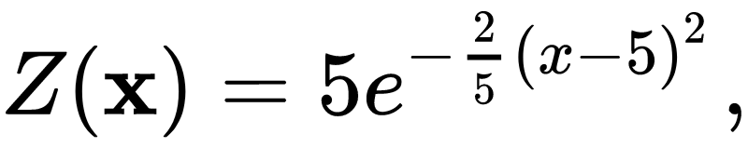
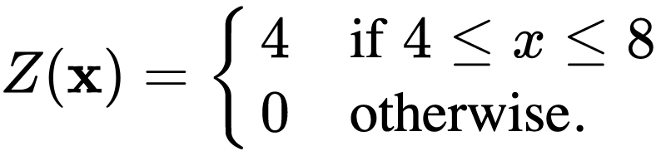
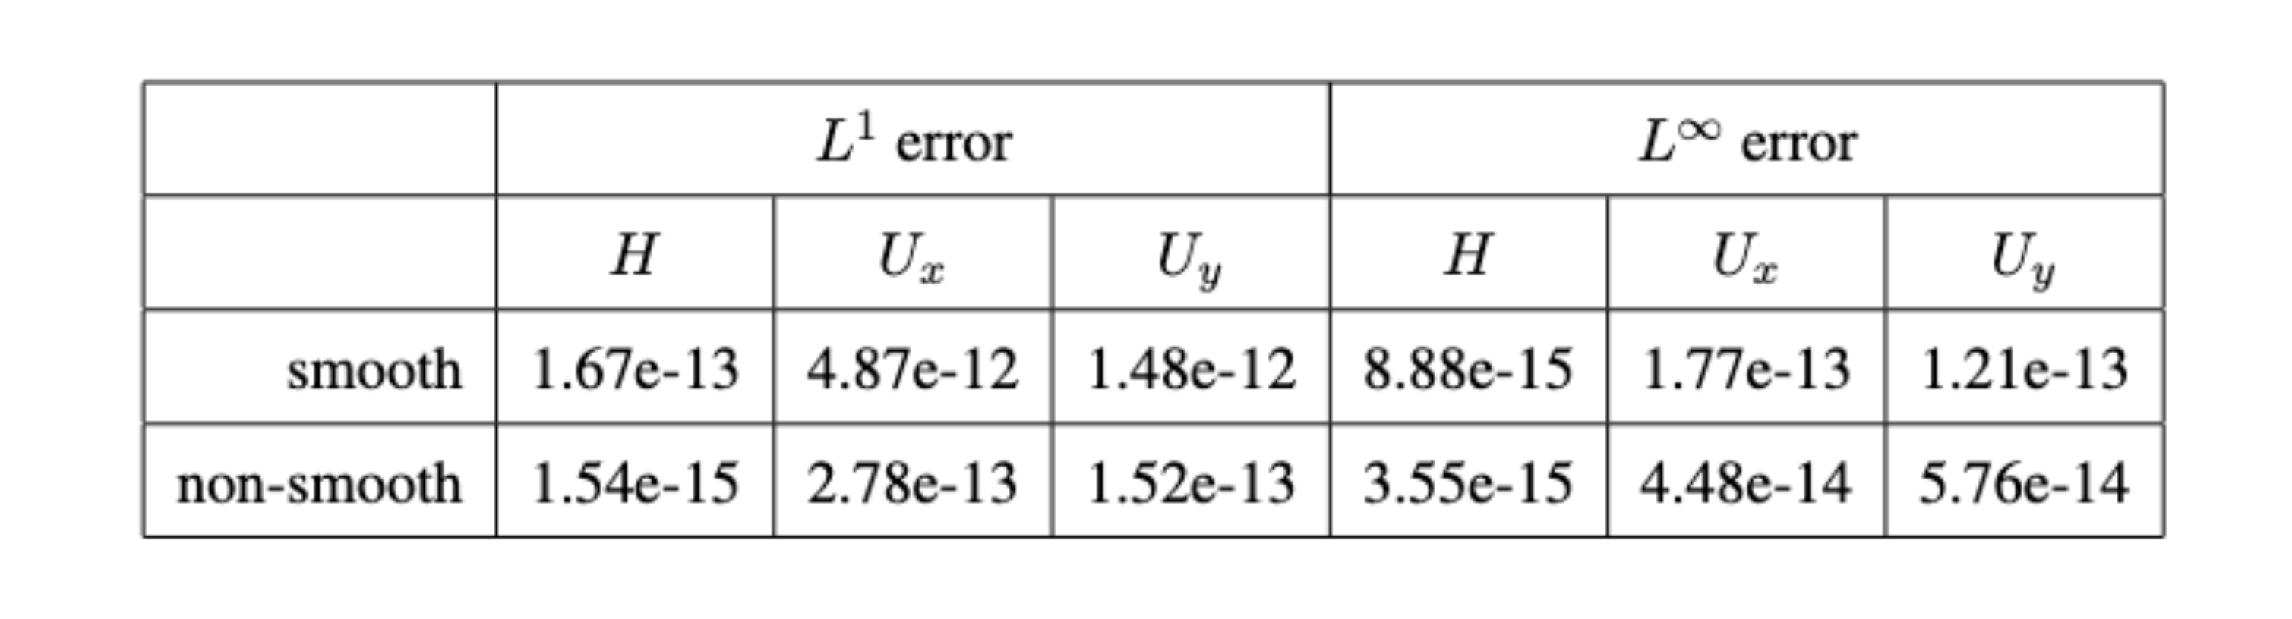
Numerical tests
We provide a well-balancing test, $, T=0.5 s,L=10 m,$
we consider a level of mesh refinement equal to eight, i.e., $2^{16}$ total mesh elements,

Slide 11
TG2 vs Splitting IMEX-RKC TG2
We compare the performance of the Splitting method wrt the classical TG2 scheme on a simple test case, a radial dam-break problem with Newtonian rheology. We use the following parameters, $ρ=1 kg/m^{3}$, $g=1 m/s^{2}$, $μ=5 Pa s, T=1 s,L=5 m$.
[Gatti, F., de Falco, C., Perotto S, Formaggia L.. (2022). A positivity-preserving well-balanced numerical scheme for the simulation of fast landslides with efficient time stepping. In preparation: Applied Mathematics and Computation.]

Slide 12
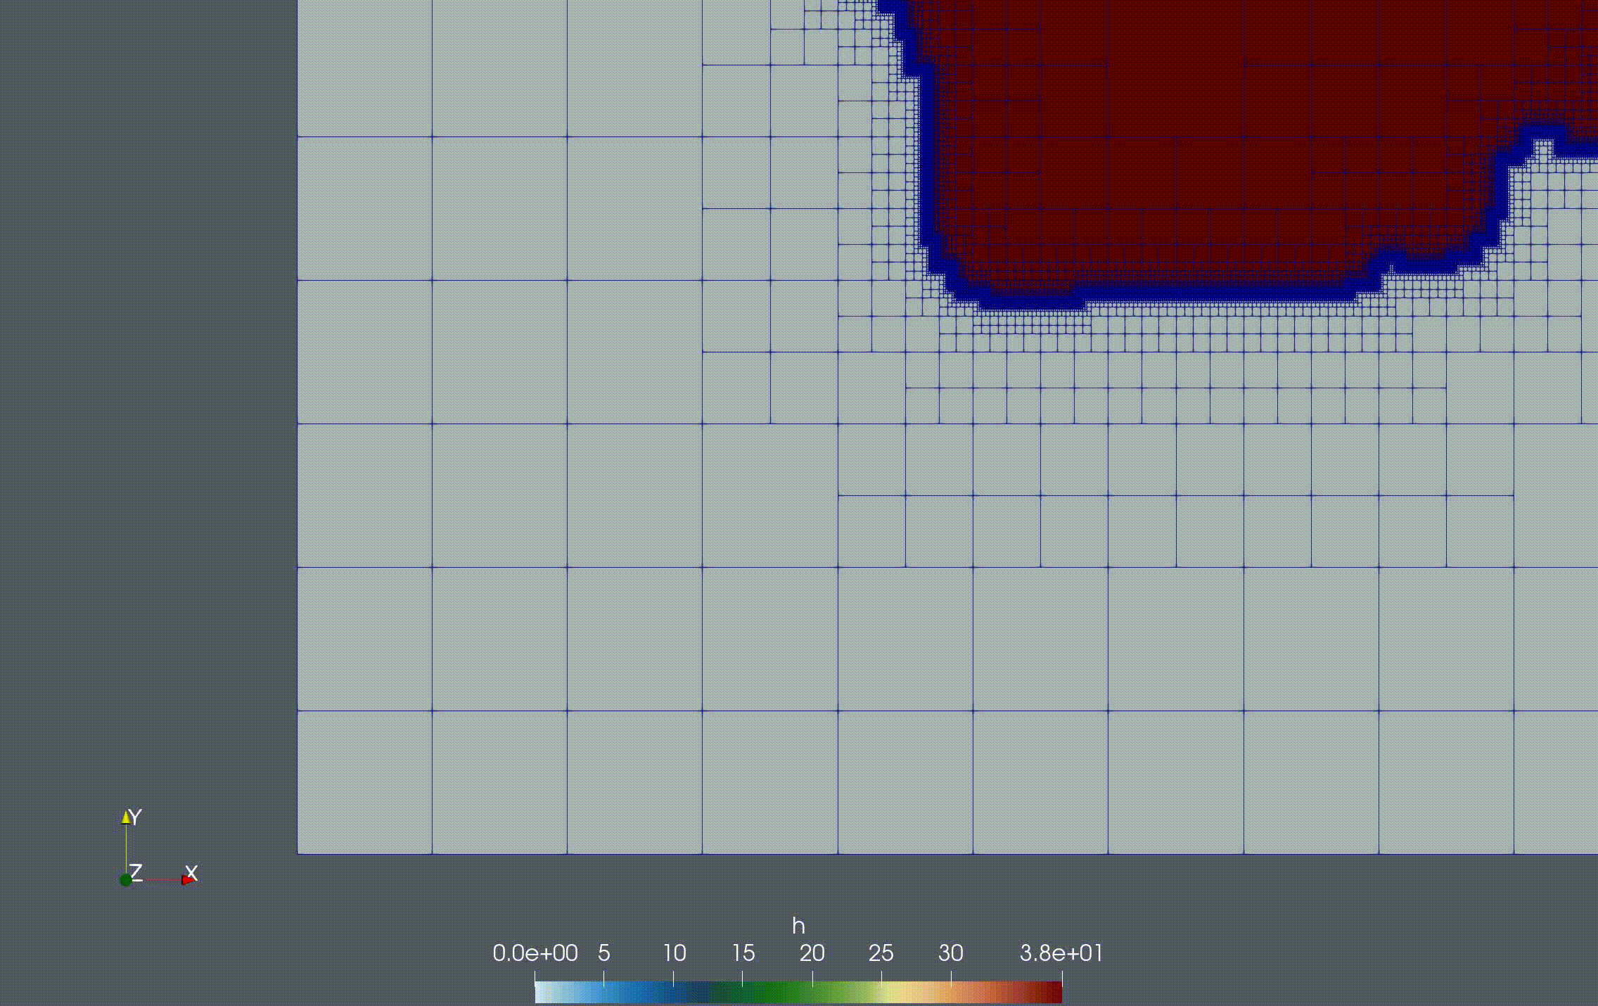
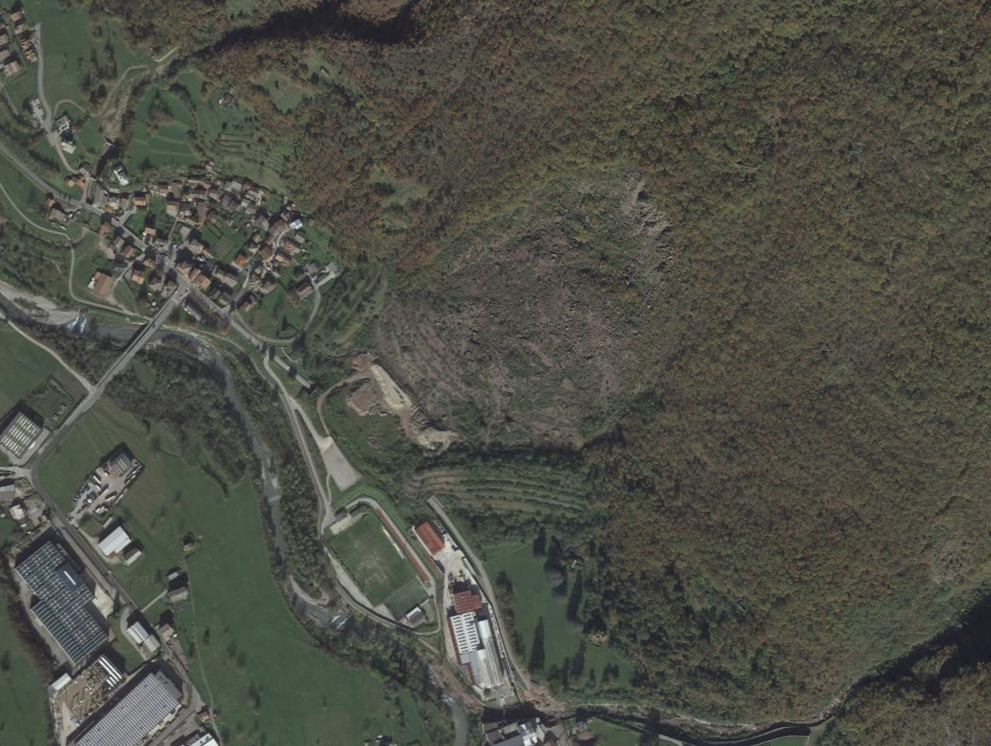
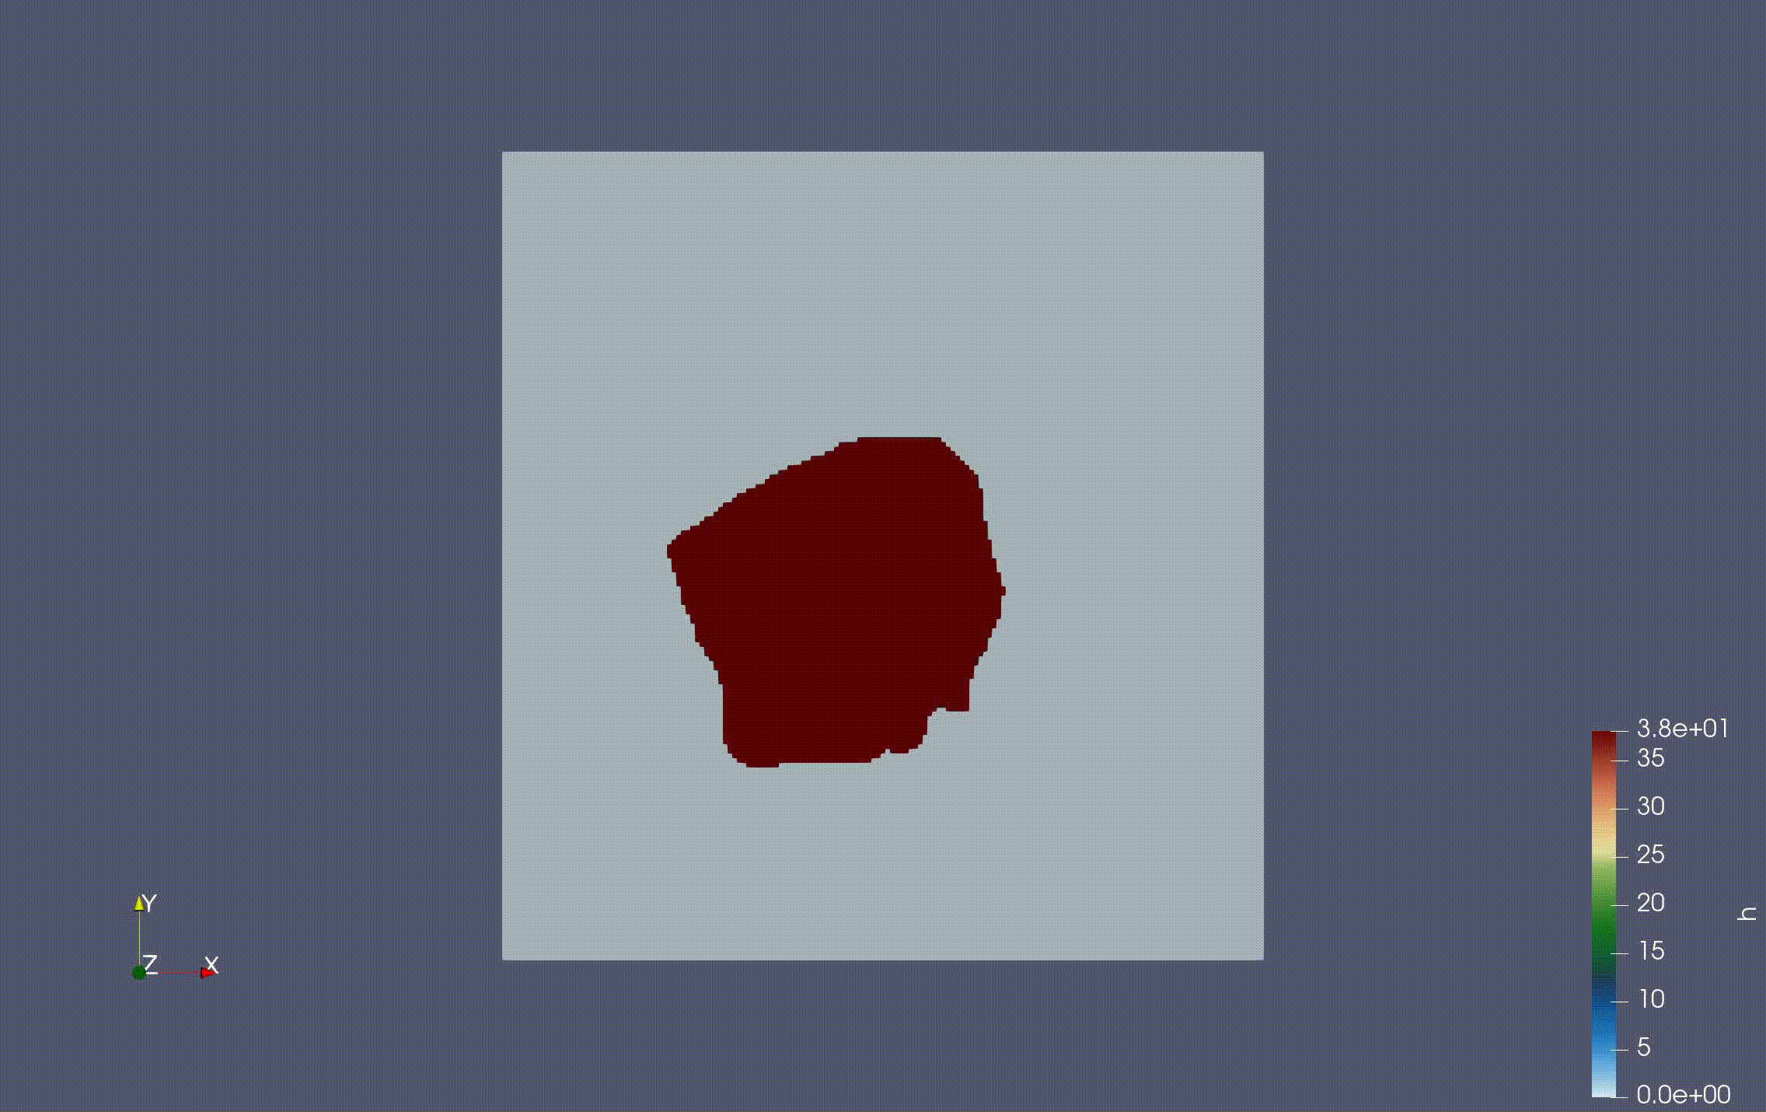
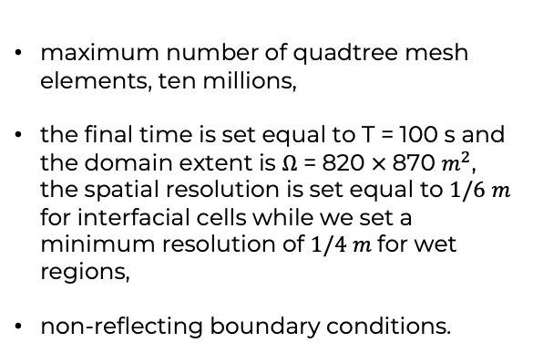
A real case study
maximum number of quadtree mesh elements, ten millions,
the final time is set equal to T = 100 s and the domain extent is $Ω$ = 820 $×$870 $m^{2}$, the spatial resolution is set equal to $1/6$ $m$ for interfacial cells while we set a minimum resolution of $1/4$ $m$for wet regions,
non-reflecting boundary conditions.
[Gatti, F., de Falco, C., Perotto S, Formaggia L.. (2022). A positivity-preserving well-balanced numerical scheme for the simulation of fast landslides with efficient time stepping. In preparation: Applied Mathematics and Computation.]

Slide 13
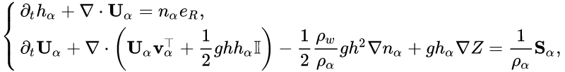
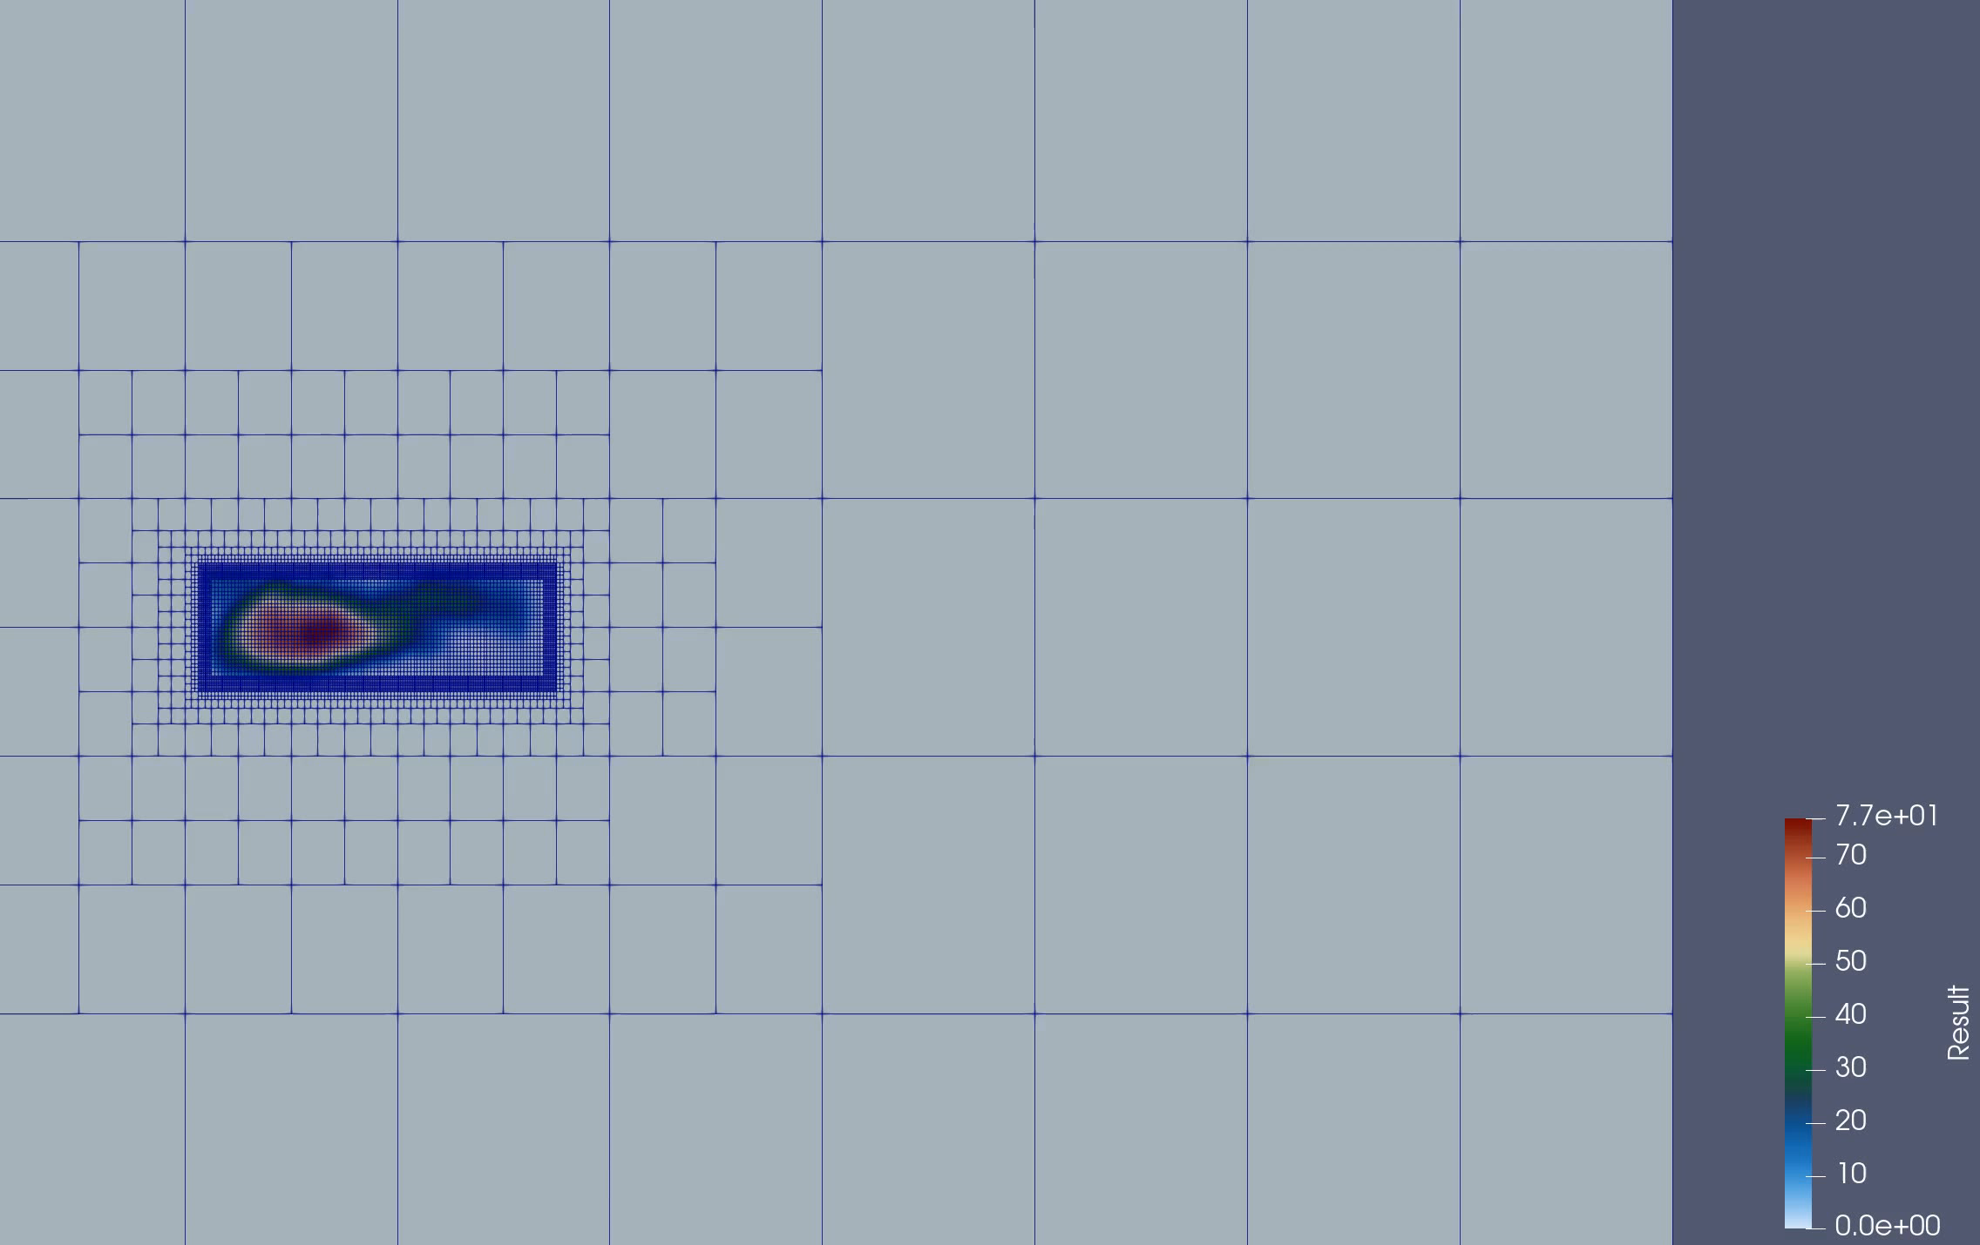
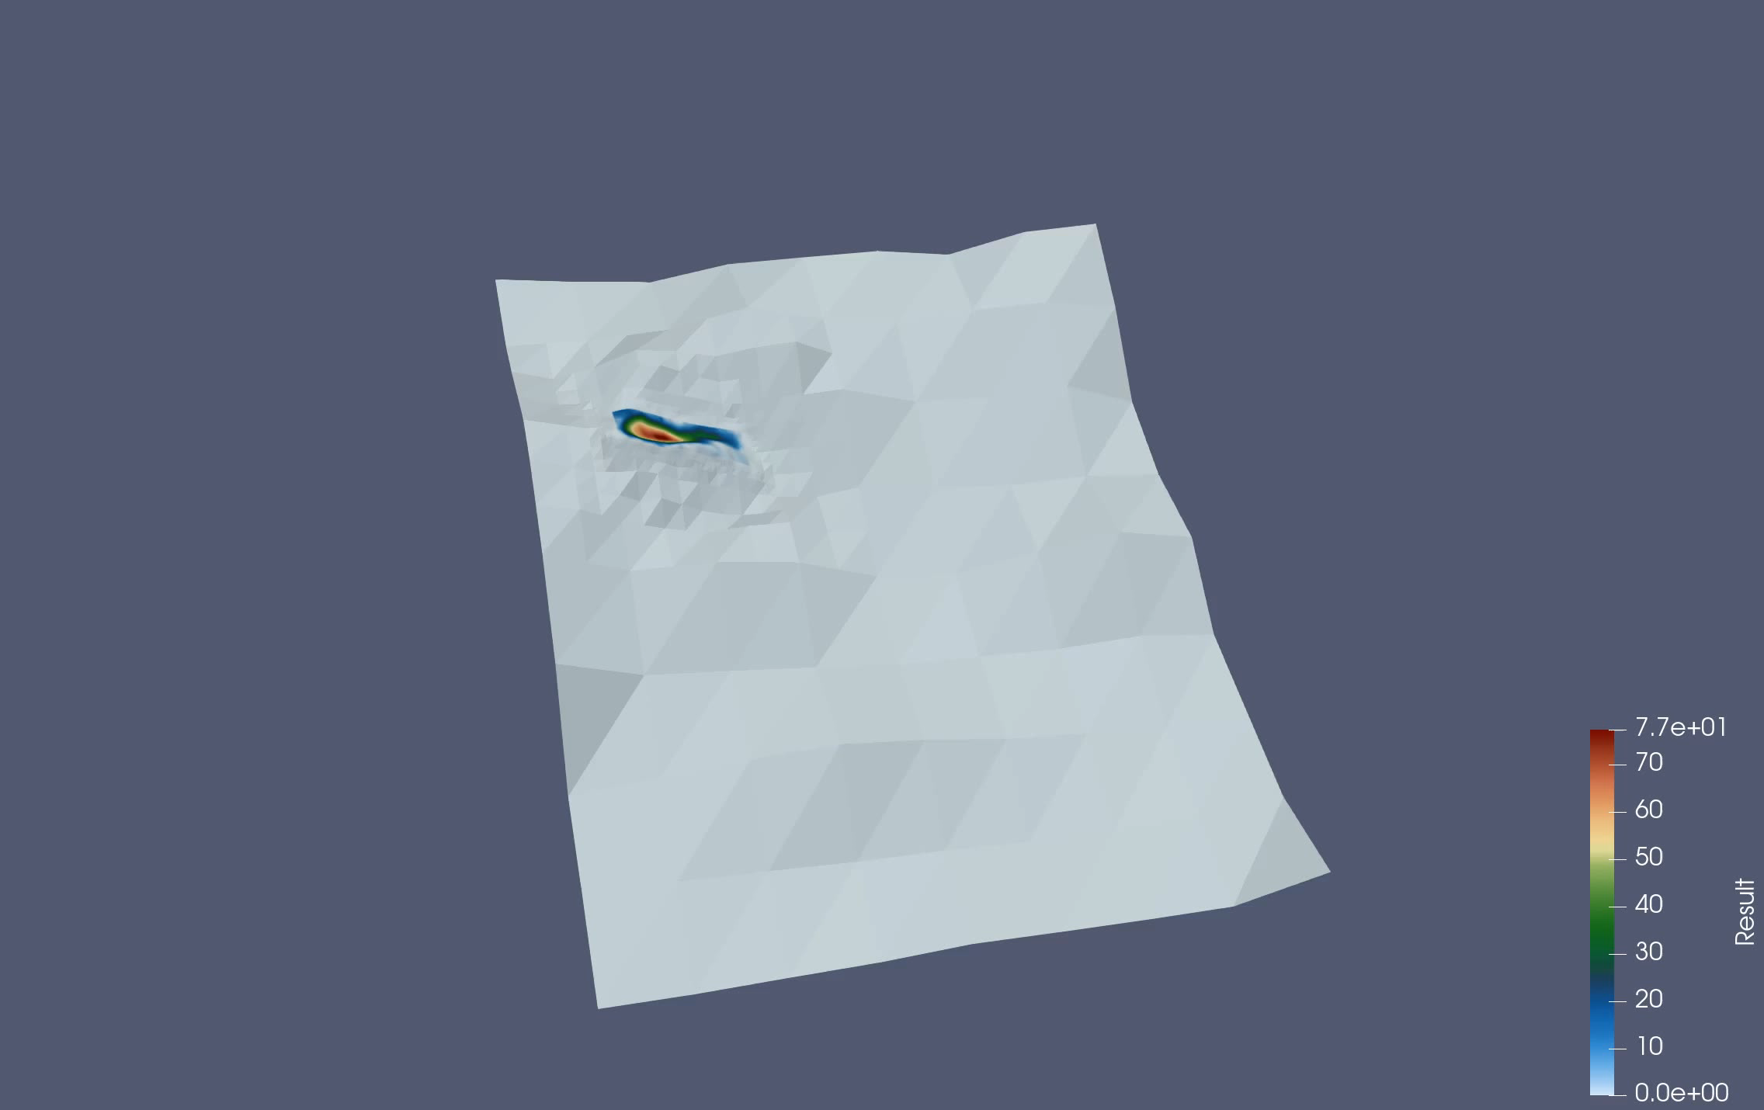




Model equations: two-phase model
The presented numerical scheme can treat also the following system of two-phase model equations,
State variables, $α=w,s$
$$h_{α}$$
Phase free-surface
$$U_{α}$$
Phase mass fluxes
$$Z$$
Orography profile

Slide 14
Conclusions and future developments
Conclusions:
We have implemented an efficient numerical framework, in terms of scaling performances, able to study fast landslides runout.
Future developments:
Test on various real scenarios possibly performing stochastic simulation activities with, e.g., the Polynomial Chaos Expansion method. Either improving the TG2 scheme to obtain a fully unconditionally stable scheme.

