Slide 1
Innovative numerical methods for evolutionary partial differential equations and applications
A survey of the activity of the Catania unit
Giovanni Russo
Sebastiano Boscarino
Armando Coco
Seung Yeon Cho
Clarissa Astuto
Emanuele Macca
+ many others (from other PRIN units or from outside)

Slide 2
Prima di iniziare…
Roma, Febbraio 2002

Slide 3
Main research themes
Semiclassical limit Schroedinger equation (GWPT) S.Jin, L.Liu; Z.Zhou, B.Miao
High order all Mach Number solvers for gas dynamics S.Boscarino, J.Qui, T.Xiong; E.Macca, Manuel Castro
Conservative semilagrangian methods for kinetic equations S.Boscarino, S.Y.Cho, M.Groppi, S.B.Yun
Multiscale model for sorption kinetics C. Astuto, A. Coco
Multifluids Duyen Phan, S.Gavrilyuk, (Simone Chiocchetti)
A PDE Models for biological network formation C.Astuto, Peter Markowich, Jan Haskovec
Approximate Taylor Methods E.Macca, Carlos Parés; R. Loubere (MOOD)
Asymptotic preserving well-balanced schemes S.Boscarino, Carlos Parés, Manuel Castro, Irene Gomez-Bueno
S. Boscarino
A. Coco
D. Phan
C. Astuto
E. Macca
G.R.

Slide 4
Hyperbolic systems with relaxation
Consider a system of the form
$$u_{t}+v_{x}=0$$
$$v_{t}+a^{2}u_{x}=\frac{1}{ε}(f(u)-v)$$
Left hand side: linear hyperbolic with eigenvalues
$$λ_{±}=±a$$
Right hand side is a relaxation: formally as $ε→0$ it gives
$$v=f(u)⇒u_{t}+f(u)_{x}=0$$
(Relaxed equation)
The formal limit becomes rigorous if the following subcharacteristic condition
$$|f^{′}(u)|≤a$$
is satisfied.
This approach is the basis of the Relaxation schemes by Xin and Jin (CMAP, 1995)

Slide 5
Generalisation
More general relaxation system has the structure
$$U_{t}+F(U)_{x}=\frac{1}{ε}R(U)$$
(1)
$$U(x,t)∈R^{M}$$
and$∇_{U}F$ defines a hyperbolic system
$R(U)$ is a relaxation if $∃Q∈R^{m×M},m<M,|QR(U)≡0∀U∈R^{M},$
This means that $u=QU$ are conserved:
$$u_{t}+QF(U)_{x}=0$$
Furthermore a relaxation implies that $R(U)=0$ is uniquely solved as $U=E(u)$
Formally as $ε→0$ one has $U=E(u)$
The equation relaxes to a $m$ dimensional system:
$$u_{t}+f(u)_{x}=0$$
With $f(u)=QF(E(u))$.
[T.P.Liu 1987; Chen, Levermore and Liu, 1994]

Slide 6
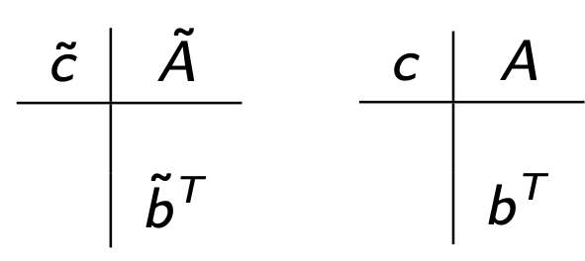
IMEX schemes
Presence of a stiff terms requires implicit treatment of the source
Quasilinear hyperbolic is in general not stiff $⇒$ can be treated explicitly.
Natural choice: IMEX schemes.
RK-IMEX
Defined by a double Butcher tableau
$$U^{(i)}=U^{n}-Δt\overset{i-1}{\underset{j=1}{∑}}{\overset{˜}{a}}_{ij}D_{x}F(U^{(i)})+\frac{Δt}{ε}\overset{i}{\underset{j=1}{∑}}a_{ij}R(U^{(j)})$$
$$U^{n+1}=U^{n}-Δt\overset{s}{\underset{i=1}{∑}}{\overset{˜}{b}}_{i}D_{x}F(U^{(i)})+\frac{Δt}{ε}\overset{s}{\underset{i=1}{∑}}b_{i}R(U^{(i)})$$
$${\overset{˜}{c}}_{i}=\underset{j}{∑}{\overset{˜}{a}}_{ij}$$
$$c_{i}=\underset{j}{∑}a_{ij}$$
Matrix $\overset{˜}{A}$ is lower triangular with zero diagonal and $A$ is lower triangular (DIRK-RK)
Two classes of schemes: I) $A$ non singular; II) $a_{11}=0$
Additional order conditions are required to construct high order IMEX
If $\overset{˜}{b}=b$ and $\overset{˜}{c}=c$ there are zero coupling conditions for IMEX up to order 3
SSP explicit + L-stable implicit is ideal for hyperbolic systems with stiff relaxation

Slide 7
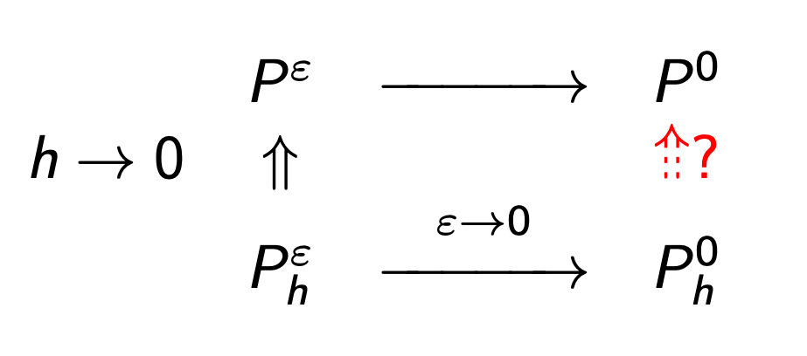
Asymptotic preserving schemes
Let $P^{ε}$ denote a problem,
$P_{h}^{ε}$ its discretisation and
$h=O(Δx)=O(Δt)$
the discretisation parameter
Is $P_{h}^{0}$ a consistent solver for $P^{0}$ ?
If so a scheme is said AP
If order of accuracy is preserved the scheme is Asymptotically Accurate
For type I schemes (matrix $A$ non singular) then
as $ε→0$ one obtains the explicit scheme for the limit equation.
$⇒$Accurate for differential variable $u$, not necessarily for algebraic one $v$
Note: if $\overset{˜}{b}=b$ and $\overset{˜}{c}=c$ $A$ is singular $⇒$ schemes has to be of type II
because $0={\overset{˜}{c}}_{11}=c_{11}=a_{11}$. Easier to construct, more difficult to analyse

Slide 8
Generalisation

Slide 9
Well-balanced schemes
Consider balance laws
$$U_{t}+F(U)_{x}=S(U,x)$$
FV space discretization
$$\frac{dU_{i}}{dt}=-\frac{F_{i+1/2}-F_{i-1/2}}{Δx}+\frac{S_{i}}{Δx}$$
$$S_{i}≈∫_{I_{i}}S(U(x,t),x)dx$$
Stationary solution $U^{e}$ solves $F(U(x))_{x}=S(U(x),x)$
If one wants to compute solutions which are close to stationary ones it is important
that a numerical scheme maintains with (exactly or with great accuracy) s.s.
A scheme is WB if it preserves stationary solutions, i.e.
$$\frac{1}{Δx}∫_{I_{i}}U^{e}(x)dx$$
Given $U_{i}^{e}=⟨U^{e}⟩_{i}$, then $U_{i}^{n}={\overline{U}}_{i}^{e}∀i⇒U_{i}^{n+1}=U_{i}^{n}∀i$
$$⟨U^{e}⟩_{i}=$$
$$\underset{m}{∑}α_{m}U^{e}(x_{i}^{m})$$
There is a huge literature on WB schemes
Look for "well balanced scheme” on Google Scholar: more than 2000 entries
Pioneering work of A.Bermudez and M.E.Vázquez-Cendón (Comp. & Fluids 1994)
Greenberg and LeRoux (SINUM ’96)

Slide 10
Construction of high-order WB schemes (1/2)
Fundamental ingredient: WB reconstruction
$$\{\overline{u_{i}}→P_{i}(x;\{{\overline{u}}_{j}\})$$
$$P_{i}\left(x;\{{\overline{u}}_{j}^{e}\}\right)=u^{e}(x)∀x∈I_{i}$$
Standard reconstr. are in general not WB
$P_{i}$ is WB if
How can we compute it?
Given cell averages $\{{\overline{u}}_{j}\}$ compute local stationary solution $u_{i}^{e}(x):$$⟨u_{i}^{e}⟩_{i}={\overline{u}}_{i}∀i$
Compute fluctuations $v_{j}={\overline{u}}_{j}-⟨u_{i}^{e}⟩_{j},j∈S_{i}$
Apply reconstruction $Q$ to the fluctuations: $Q_{i}(x)=Q_{i}(x;\{v_{j}^{n}\})$
Set $P_{i}(x)=u_{i}^{e}(x)+Q_{i}(x)$
Such reconstruction is said Exactly WB.
Remark
If exact solution $u_{i}^{e}(x)$ cannot be computed, then one can compute
a numerical solution by solving the ODE system $F(u(x))_{x}=S(u(x),x)$ in each cell
and impose $⟨u_{i}(x)⟩={\overline{u}}_{i}$ by using either
explicit RK + Newton (Gomez-Bueno, Castro, Parés, 2021)
Or RK collocation methods (Gomez-Bueno, Castro, Parés, G.R. 2021)
In this case we talk about WB rather than EWB reconstruction.

Slide 11
Construction of high-order WB schemes (2/2)
In principle, the semidiscrete WB scheme is written as
(*)
$$\frac{du_{i}}{dt}=-\frac{F_{i+1/2}-F_{i-1/2}}{Δx}+\frac{S_{i}}{Δx}$$
$$S_{i}=∫_{I_{i}}S(P^{t}(x;\{u_{j}\},x)dx$$
with
with $F_{i+1/2}$ given by a suitable numerical flux applied to the WB reconstruction.
In practice replacing exact integral by quadrature may destroy WB property.
Remedy: since $u_{i}^{e}(x)$ is local equilibrium one has
$$F(u_{i}^{e}(x_{i+1/2}))-F(u_{i}^{e}(x_{i-1/2}))+∫_{I_{i}}S(u_{i}^{e}(x),x)dx=0$$
Adding this identity to the above scheme and replacing both integrals by
quadrature formulas one obtains the semi-discrete WB scheme (*), with
$$S_{i}=F(u_{i}^{e,t}(x_{i+1/2}))-F(u_{i}^{e,t}(x_{i-1/2}))+Δx\underset{m}{∑}α_{m}\left(S(P_{i}^{t}(x_{im}),x_{im})-S(u_{i}^{e,t}(x_{im}),x_{im}\right)$$
This approach has been proposed by Parés and coworkers
(See, for example, Castro, Morales, Parés, Handbook Num. Anal. 2017)

Slide 12
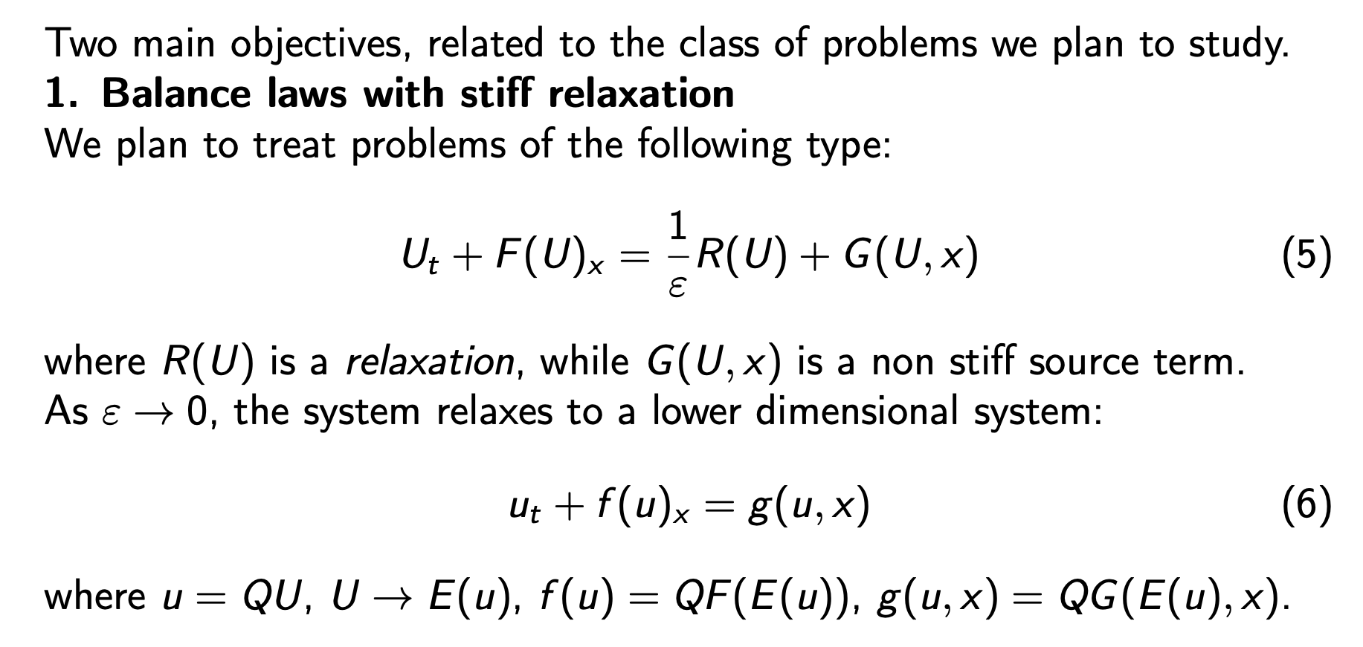
Motivation (1/2)
(*)
Goal: Construct a scheme which is AP with respect to the limit system,
and which relaxes to a scheme which is WB for the relaxed balance system (*). Such scheme will be said to be AP-WB.

Slide 13
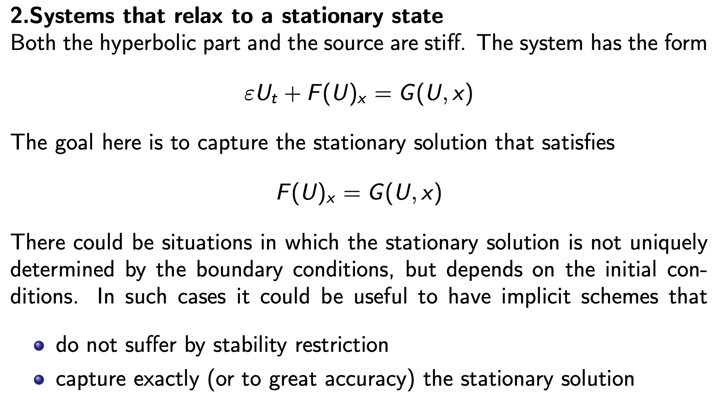
Motivation (2/2)
Starting point: construction of implicit or semi-implicit WB schemes

Slide 14
Balance systems with stiff relaxation
Consider the system
$$u_{t}+f(u)_{x}=S(u,x)$$

Slide 15
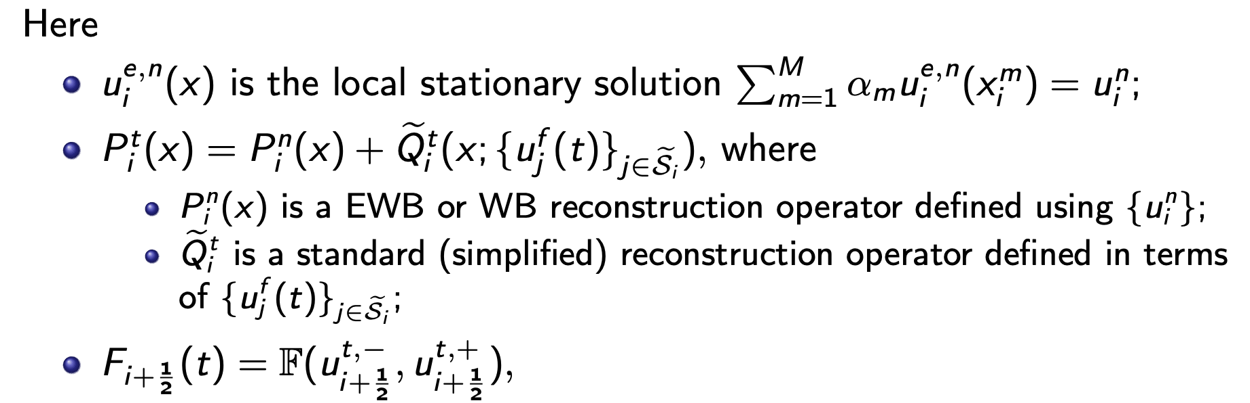
The following result holds:
Theorem. Given a stationary solution of the above system. If $P_{i}^{n}$ is an EWB reconstruction operator, then the numerical method above is EWB for $u^{e}$.
A similar result also holds if we replace exactly well-balanced by
well-balanced, that is numerically computed local steady states.

Slide 16
We adopt stiffly accurate DIRK, i.e. $b_{i}=a_{s,i}$ $⇒$ Num. sol. = last stage
$$P_{i}^{(k)}(x)=P_{i}^{n}(x)+{\overset{˜}{Q}}^{(k)}(x;\{u_{j}^{f,k}\}_{j∈{\overset{˜}{S}}_{i}}),k∈\{1,s\}$$
Where
$${\overset{˜}{Q}}_{i}^{(k)}(x)=u_{i}^{f,k}+Δ_{i}u^{f,k}(x-x_{i}),k∈\{1,s\}$$
$$Δ_{i}u^{f,k}≈∂_{x}u^{f,k}(x)|_{x=x_{i}}$$
(slope limiter)

Slide 17
Semi-implicit scheme
Second order IMEX:
$$γ=(2-\sqrt{2})/2$$

Slide 18
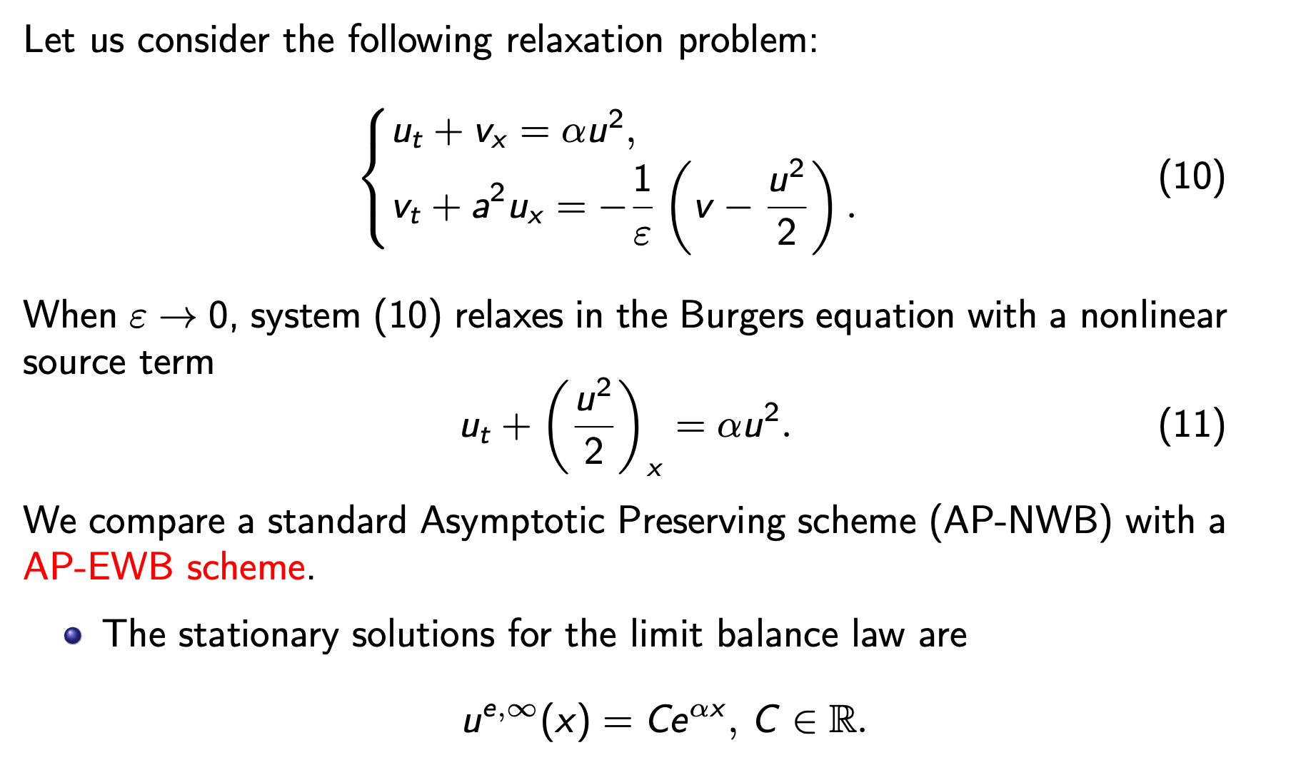
Numerical tests
System that relaxes to Burgers equation with source

Slide 19
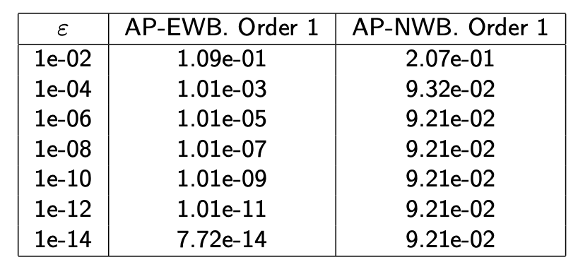
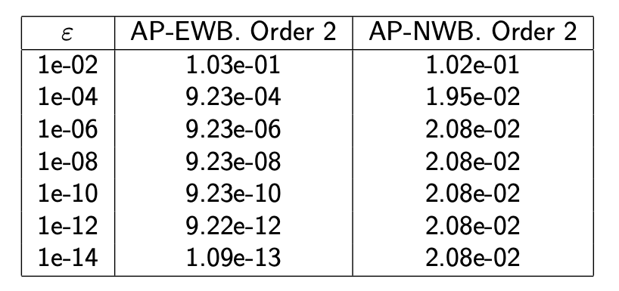
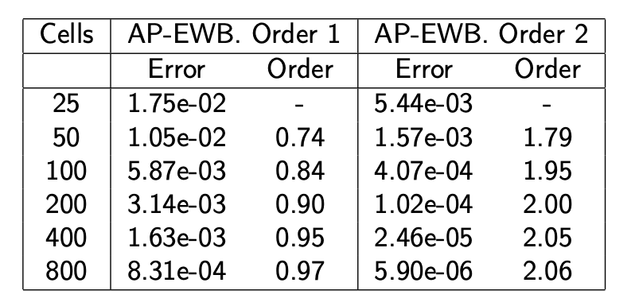
Error, order and asymptotic WB property
Differences in L1-norm with respect to the exact limit steady state $t=50$
For various $ε$. $Δx=0.005$ (left) and $Δx=0.02$ (right)
starting with analytically stationary solution of limit Burgers - above
Or with a perturbation (that leaves the domain in finite time) - below
Initial condition
Differences in L1-norm with respect to the exact
limit steady state $t=50,Δx=0.02,ε={10}^{-20}$
Error and order at time t=0.5

Slide 20
Shallow water system - no friction

Slide 21
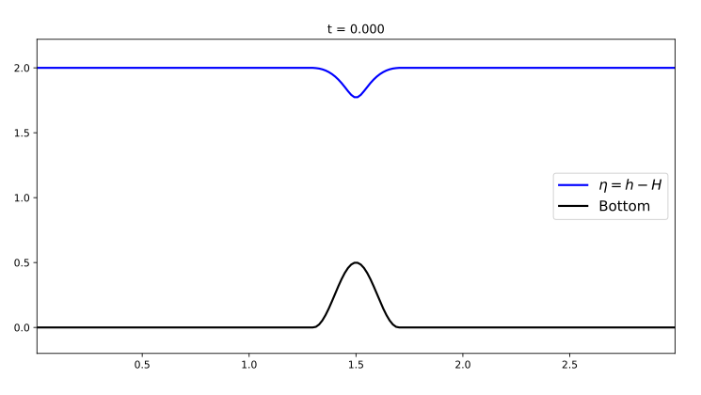
Shallow water system - no friction
Fully implicit schemes: flux and source term treated implicitly
IWBM1, IWBM2
Semi-implicit schemes:
SIWBM1, SIWBM2
First test: check WB property
$t∈[0,1]$, CFL = 2.0
Stencil depends on reconstruction $\overset{˜}{Q}$
Initial condition: subcritical stationary solution

Slide 22
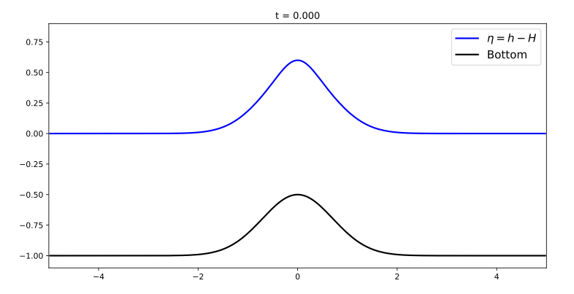
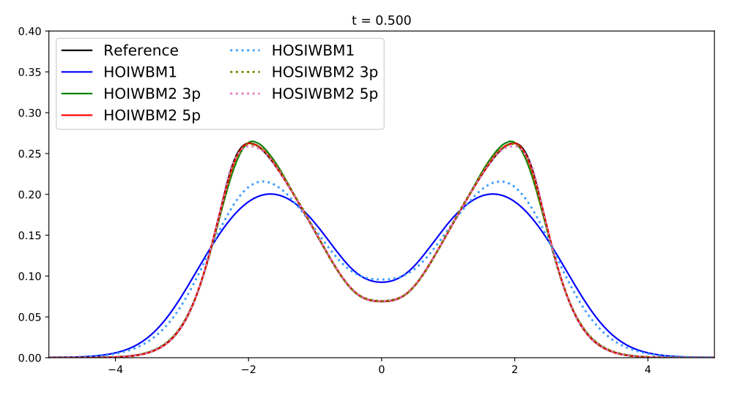
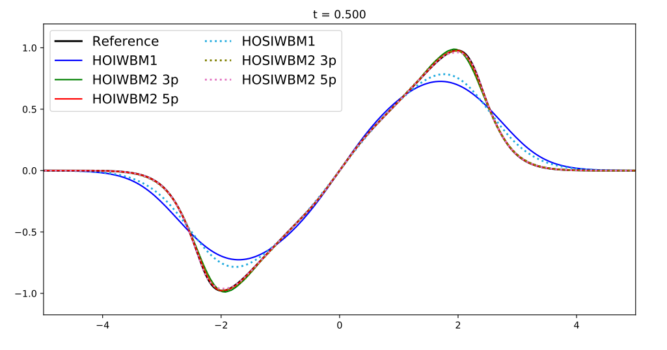
Shallow water system - no friction
Transient solution
Depth function: $H(x)=1.0-0.5e^{-x^{2}}$
Initial condition: $q_{0}(x)=0,h_{0}(x)=H(x)+0.1e^{-5x^{2}}$
Reference solution: 1600-cell mesh,
5-point stencil SIWBM2
Free surface $η(x,t)$
Discharge $q(x,t)$

Slide 23
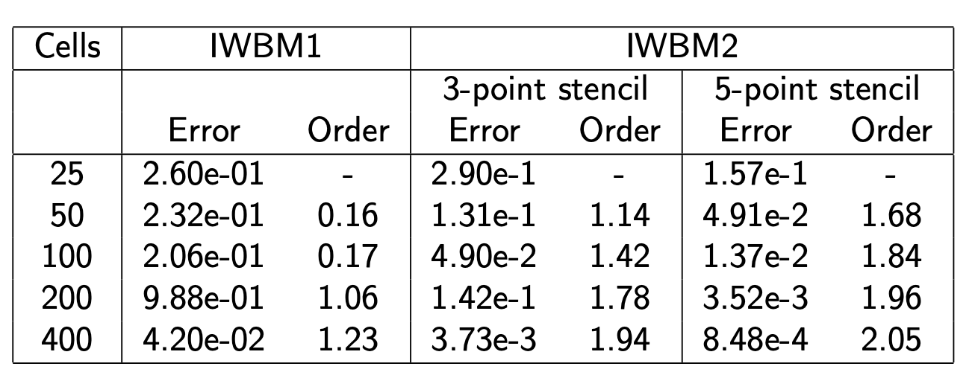
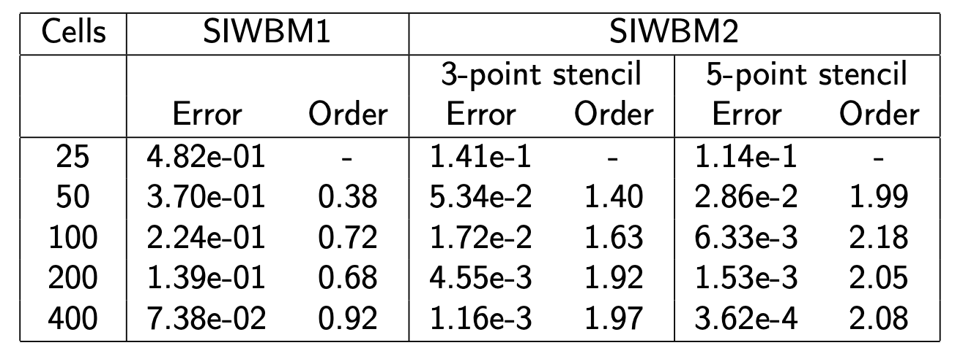
Shallow water - order of accuracy
Comparison with reference solution $L^{1}$ error and converge order

Slide 24
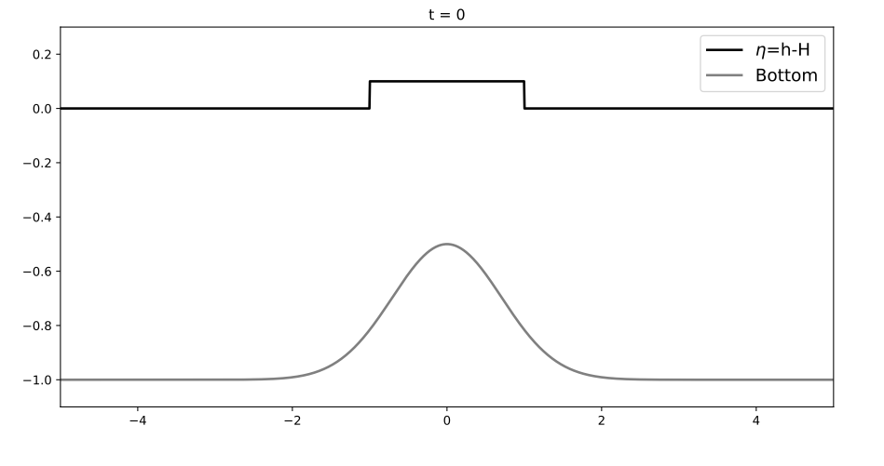
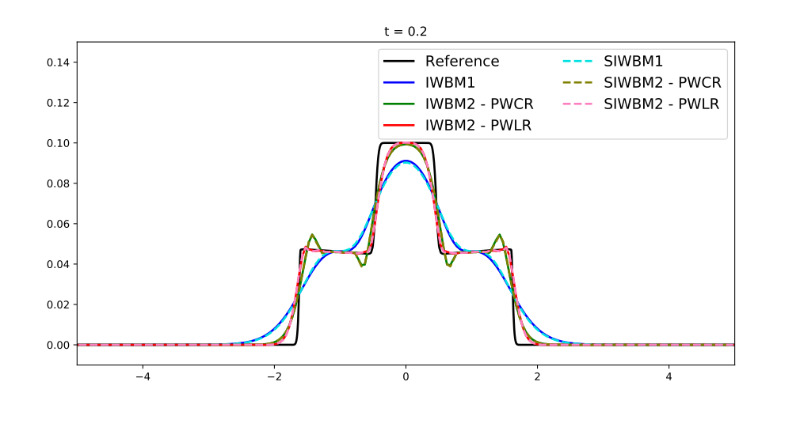
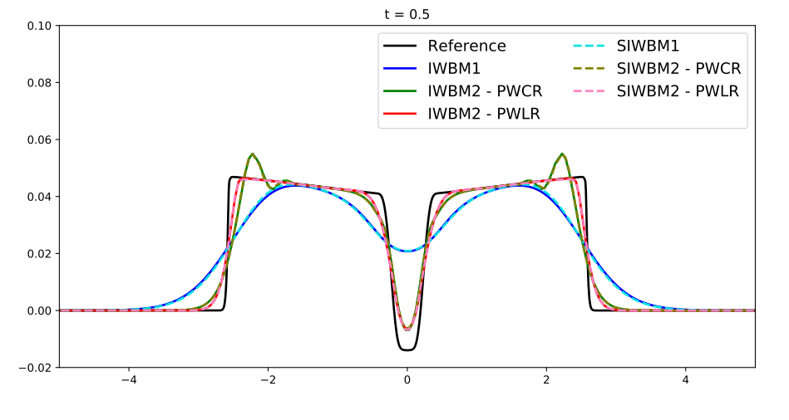
Shallow water system - no friction
Test shock shock capturing capability
Various schemes: Implicit and Semi-I
First and second order accurate
Constant and linear reconstruction $\overset{˜}{Q}$
Initial condition
$η(x)$ at $t=0.2$
$η(x)$ at $t=0.5$

Slide 25
1D shallow-water system with topography and friction
Consider
with
$n(=0.032)$ is the Manning friction coefficient and $μ=7/3$
Stationary solutions satisfy the ODE system:
Bathimetry

Slide 26
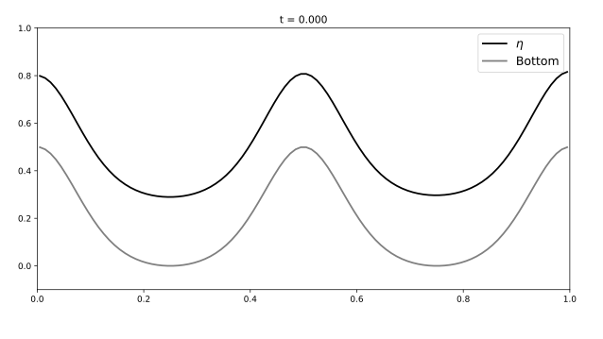
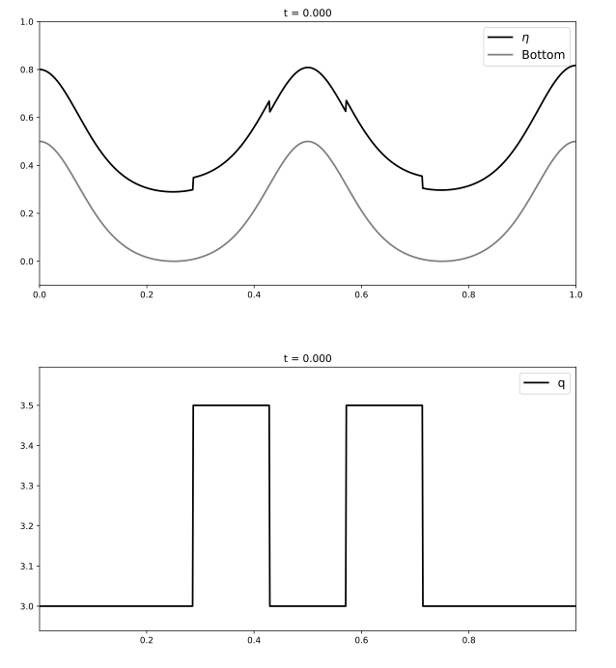
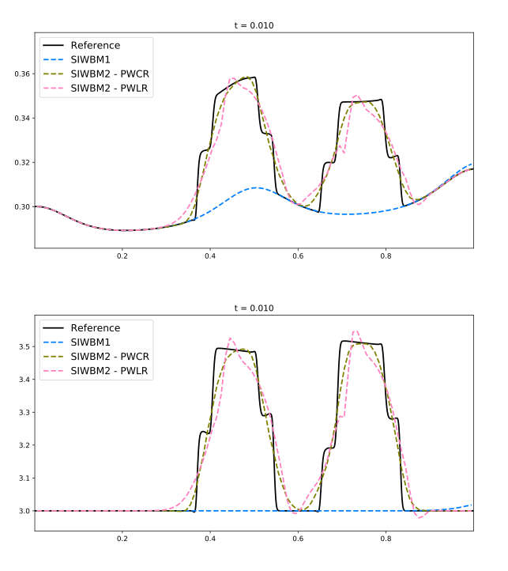
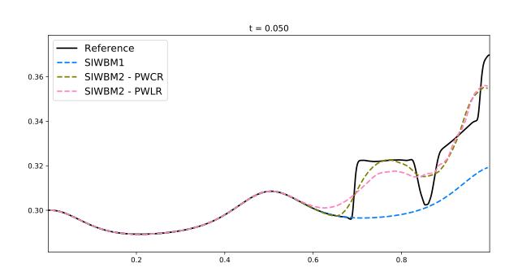
1D shallow-water system with topography and friction
Stationary initial condition
All (implicit, semi-implicit, 1st, 2nd order) schemes
preserve stationary solution within machine precision
$$t=0.05$$
100 cells. Underresolved
1st order not sufficient
$$t=0$$
$$t=0.01$$
$$t=2.0$$

Slide 27
Conclusions
A general framework has been presented to construct high-order well-balanced implicit and semi-implicit numerical schemes for systems of balance laws.
Within this framework APWB schemes could also be designed from standard AP schemes. AP-EWB schemes exactly capture the steady states of the limit balance law when ε → 0.
The key idea is to consider local high-order well-balanced reconstruction operator.
Work in progress
Application to more complex systems
Extension to several space dimensions
Application to fast detection of global stationary solutions
Thank you for your attention!

