Slide 1
Dealing with curl involutions via GLM curl cleaning and exactly curl-free schemes
Michael Dumbser
S. Busto, S. Chiocchetti, F. Dhaouadi, E. Gaburro,
S. Gavrilyuk, I. Peshkov
PRIN 2017
Final PRIN workshop, Catania, 20/2/2023

Slide 2
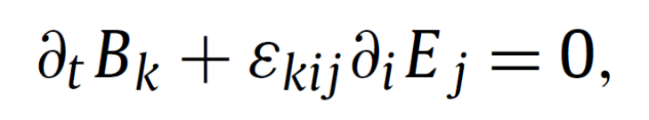
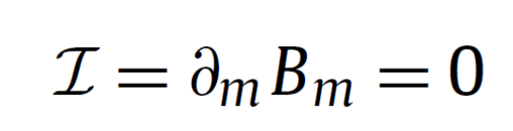
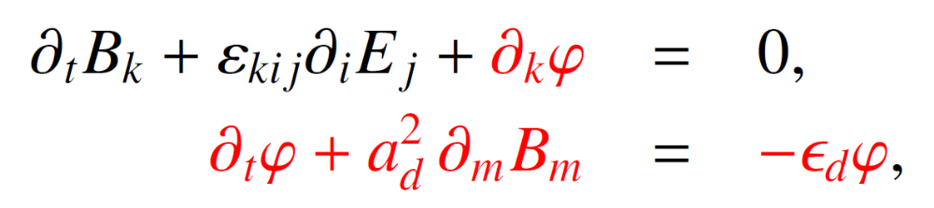
The induction equation as a prototype model with involution
Induction equation in the Maxwell/MHD equations
(involution constraint)
Generalized Lagrangian Multiplier (GLM) approach of Munz, Sonnendrücker, Omnes et al., (2000, 2002) which propagates divergence errors via acoustic-type waves using a div-grad pair of operators (similar to the incompressible limit of the compressible Navier-Stokes equations), a cleaning scalar φ and an artificial cleaning speed a_{d} :

Slide 3
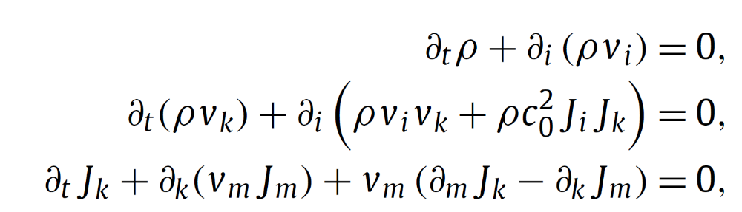
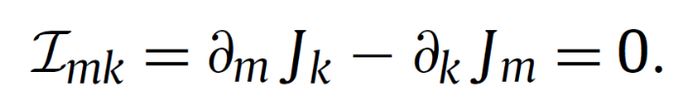
A toy model with curl involution
Consider the system endowed with a curl involution on the field J:
(curl involution)
Extension of the Generalized Lagrangian Multiplier (GLM) approach of Munz et al. Requires to propagate curl constraints. This is achieved via a curl-curl pair, i.e. via a Maxwell-type system.

Slide 4
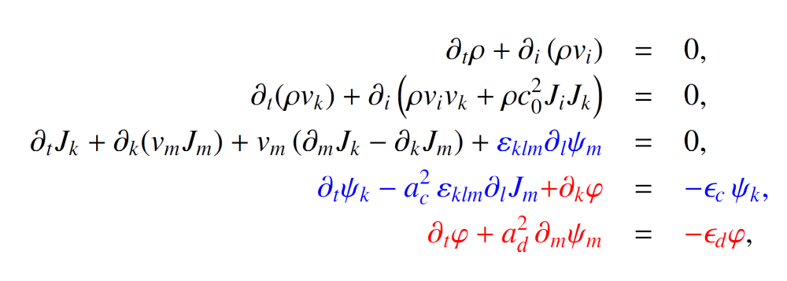
A toy model with curl involution
The augmented GLM system with curl cleaning reads:
Extension of the Generalized Lagrangian Multiplier (GLM) approach of Munz et al. Requires to propagate curl constraints. This is achieved via a curl-curl pair, i.e. via a Maxwell-type sub-system, a cleaning vector ψ, a cleaning scalar φ, an artificial curl cleaning speed a_{c} and a divergence cleaning speed a_{d}.

Slide 5

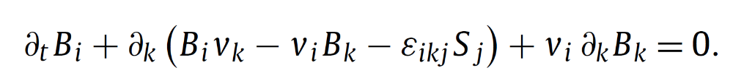
A toy model with curl involution
Consider the system with non-homogeneous involution constraint
(curl involution)
We now need to account for non-homogeneous curl-involutions, where the curl of J is equal to a new object B (Burgers vector / tensor), whose evolution equation is a consequence of the PDE for J. Note that B must be divergence-free!

Slide 6
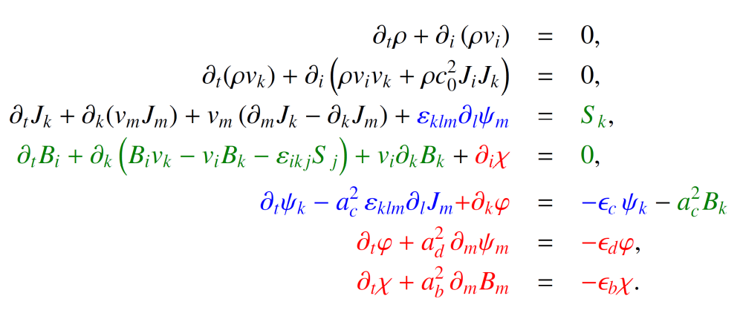
A toy model with curl involution
The augmented GLM curl cleaning system for non-homogeneous curl involutions on J reads:

Slide 7
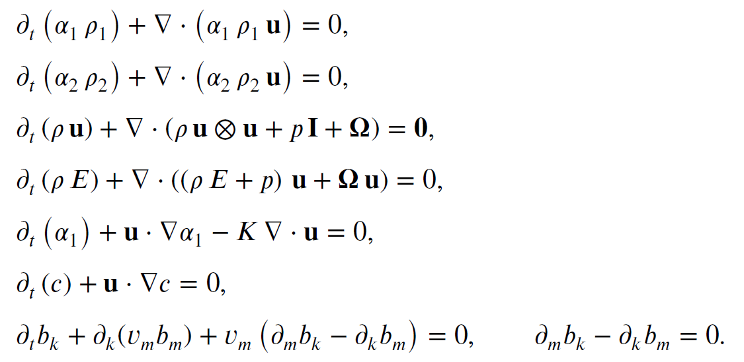
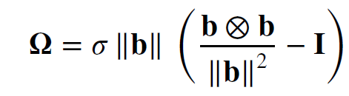
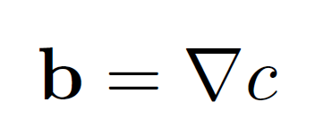
A first model from Newtonian continuum mechanics
The hyperbolic model for surface tension [Gavrilyuk et al. JCP, 2017] contains
a homogeneous curl involution for the field b.
The original model is only weakly hyperbolic (one eigenvector is missing) and thus
not directly suitable for numerical discretization (blowup).
However, it can be symmetrized and put into the Godunov form.

Slide 8
A first model from Newtonian continuum mechanics
The hyperbolic model for surface tension [Gavrilyuk et al. JCP, 2017] contains
a homogeneous curl involution for the field b.
The original model is only weakly hyperbolic (one eigenvector is missing) and thus
not directly suitable for numerical discretization (blowup).
However, it can be symmetrized and put into the Godunov form.

Slide 9
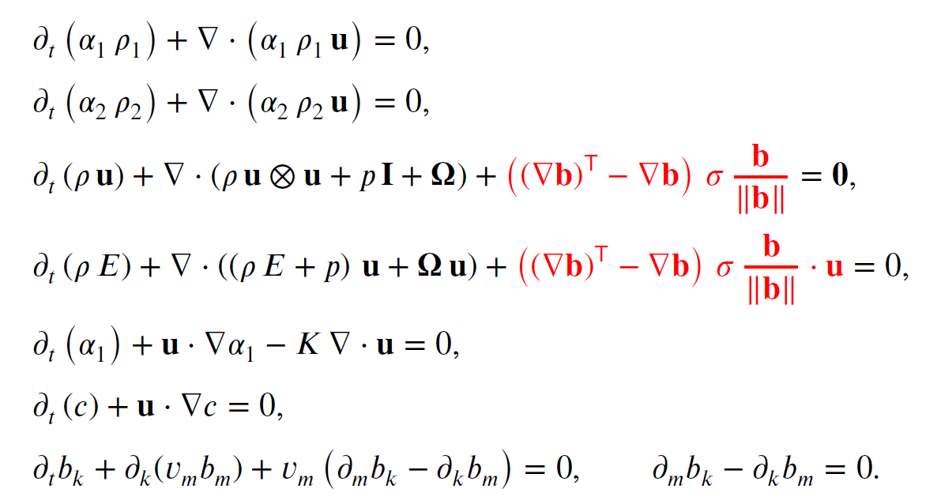
A first model from Newtonian continuum mechanics
Use of the symmetrizing non-conservative hyperbolic terms (similar to the Godunov-Powell terms in MHD) the system becomes strongly hyperbolic and suitable for numerical discretization, but conservation of momentum and energy are lost.

Slide 10
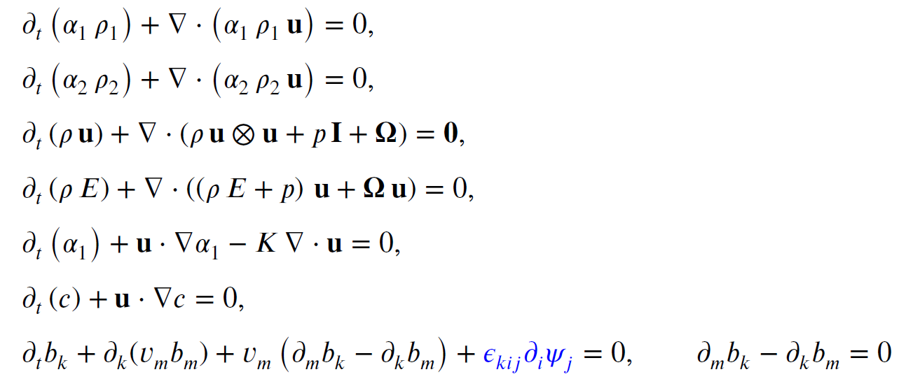
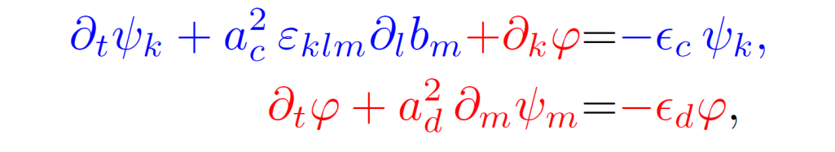
A first model from Newtonian continuum mechanics
Strong hyperbolicity can, alternatively, also be restored via our novel extension of the GLM
approach of Munz et al. 2000 and Dedner et al. 2002 for Maxwell and MHD to hyperbolic
PDE with curl-type involutions.
Unlike the Godunov-Powell terms, the GLM method conserves mass and momentum!

Slide 11
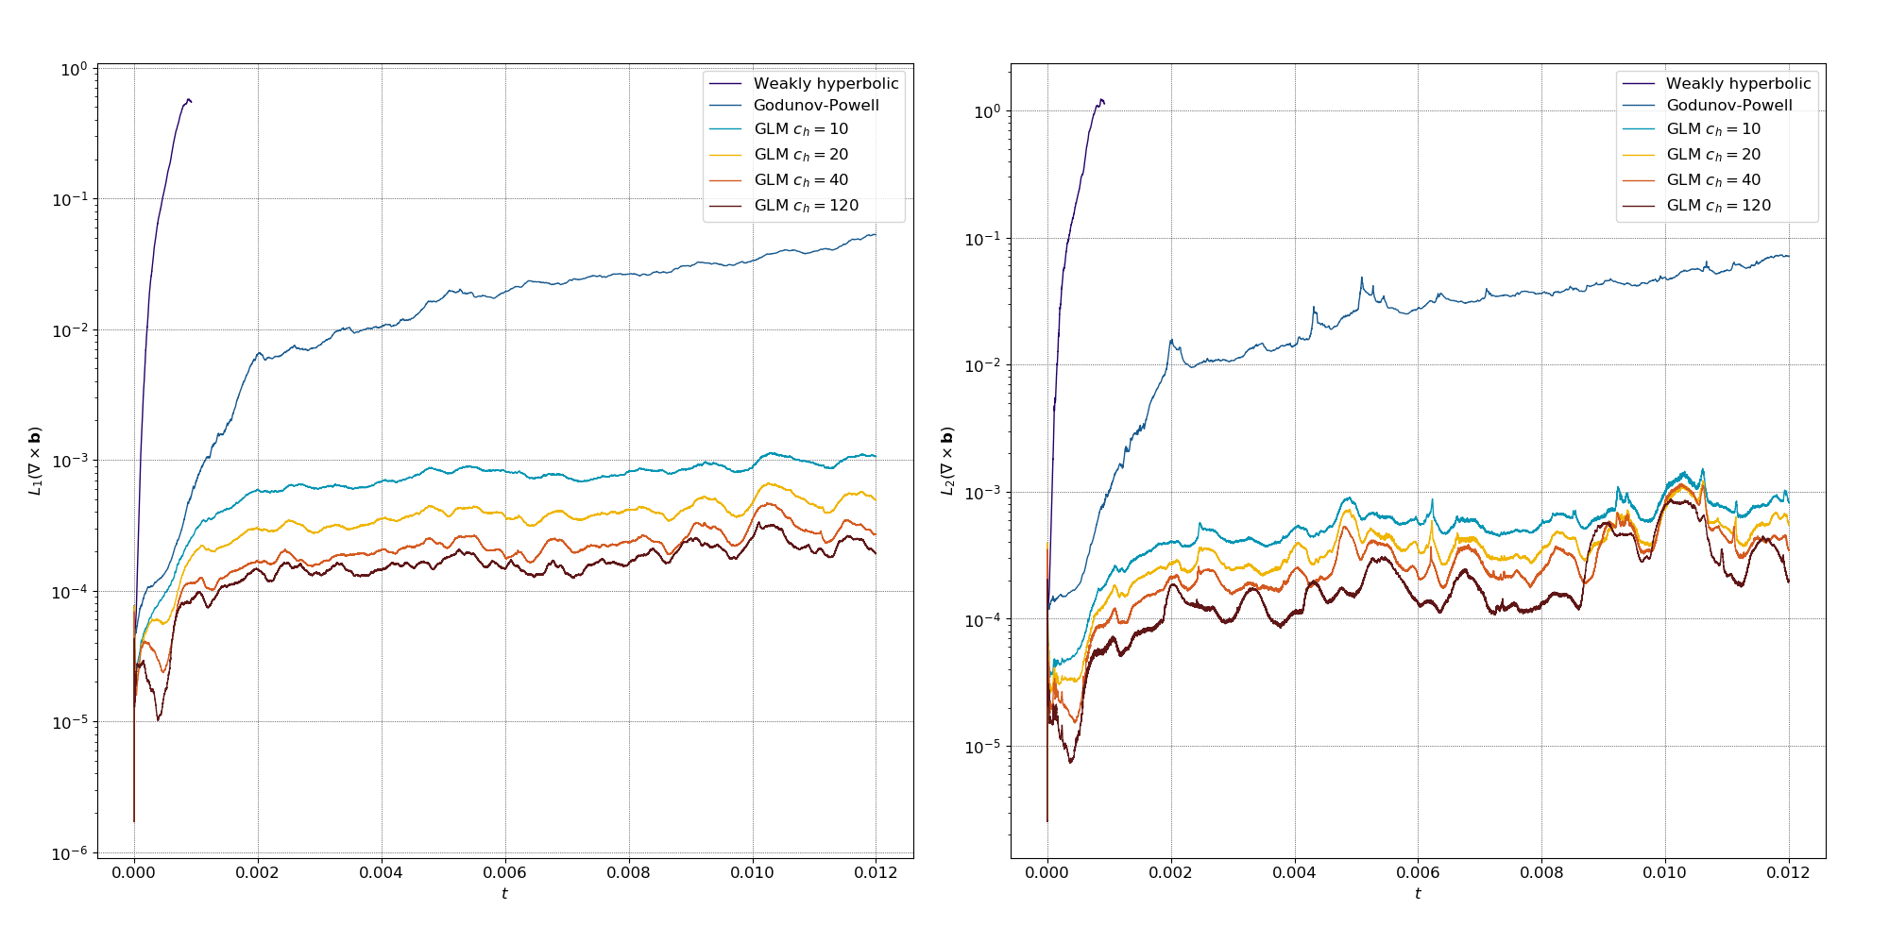
A first model from Newtonian continuum mechanics
The effectiveness of the GLM curl cleaning approach has been carefully tested in the
Newtonian setting and was also applied to general relativity:

Slide 12
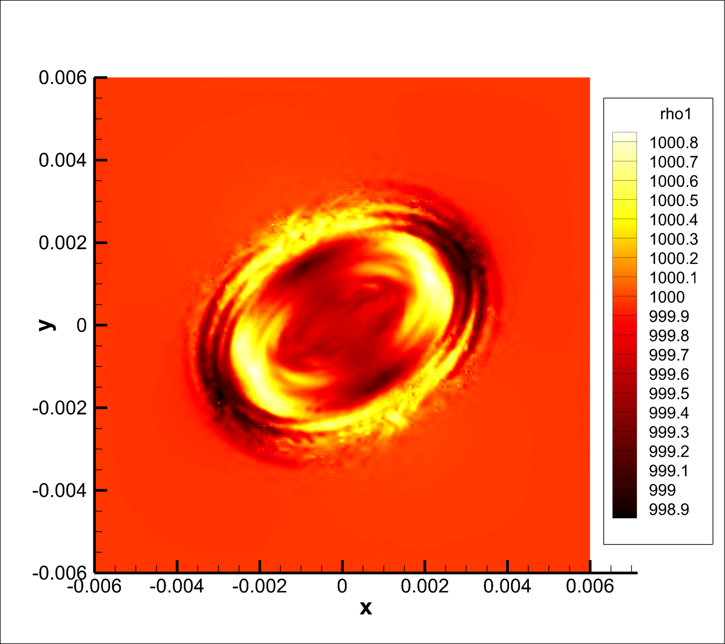
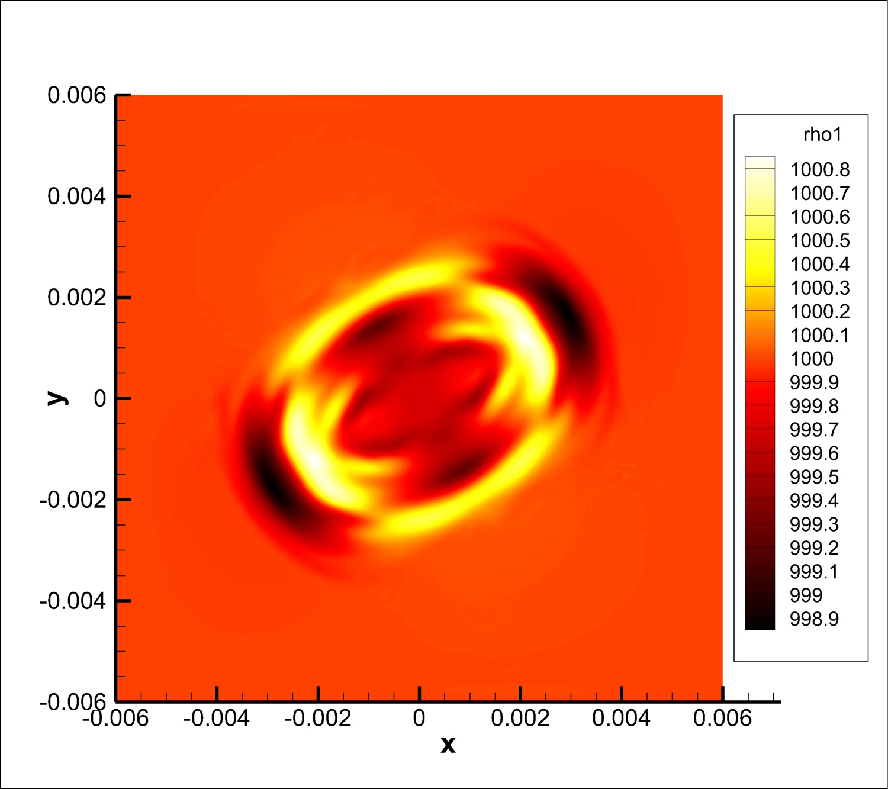
A first model from Newtonian continuum mechanics
The effectiveness of the GLM curl cleaning approach has been carefully tested in the
Newtonian setting and was also applied to general relativity:
non-conservative Godunov-Powell term
new GLM curl cleaning

Slide 13
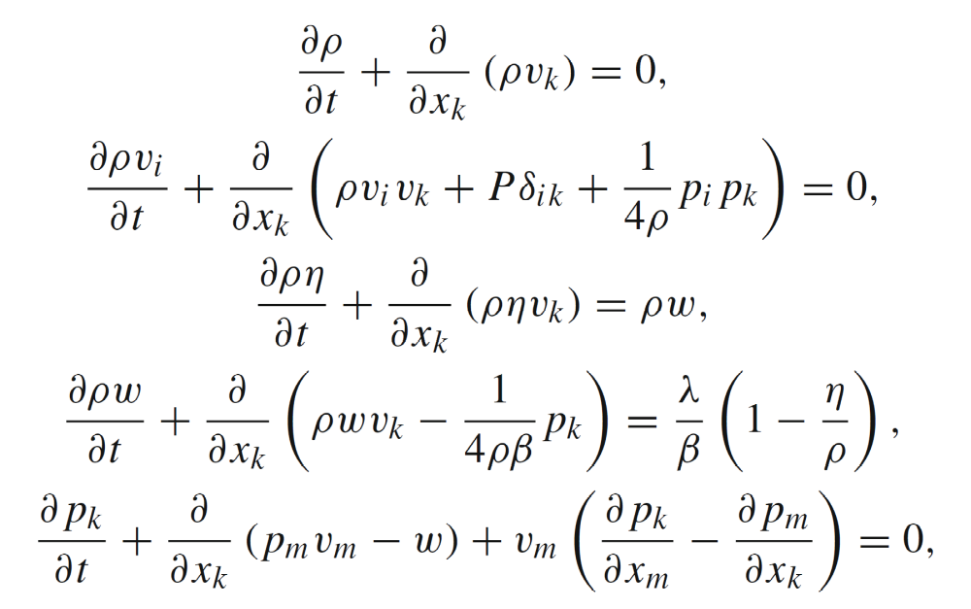
Application to (Newtonian) quantum hydrodynamics
A first order hyperbolic reformulation of quantum hydrodynamics was proposed by
Gavriluk and Dhaouadi. The system is weakly hyperbolic in multiple space dimensions,
is endowed with a homogeneous curl involution on the field p and reads:

Slide 14
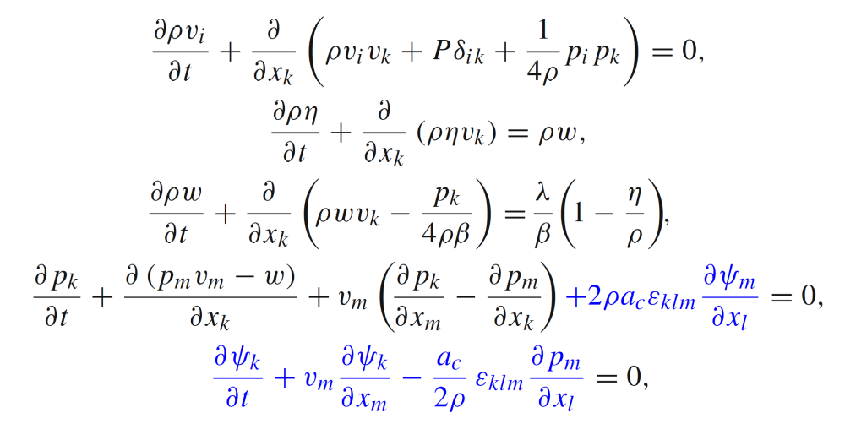
Application to (Newtonian) quantum hydrodynamics
The augmented system with a novel thermodynamically compatible GLM curl cleaning is strongly hyperbolic and reads

Slide 15
Application to (Newtonian) quantum hydrodynamics
Generation of dispersive shocks in 1D and comparison with the Whitham envelope

Slide 16
Application to (Newtonian) quantum hydrodynamics
Generation of dispersive shocks in a Bose-Einstein condensate

Slide 17
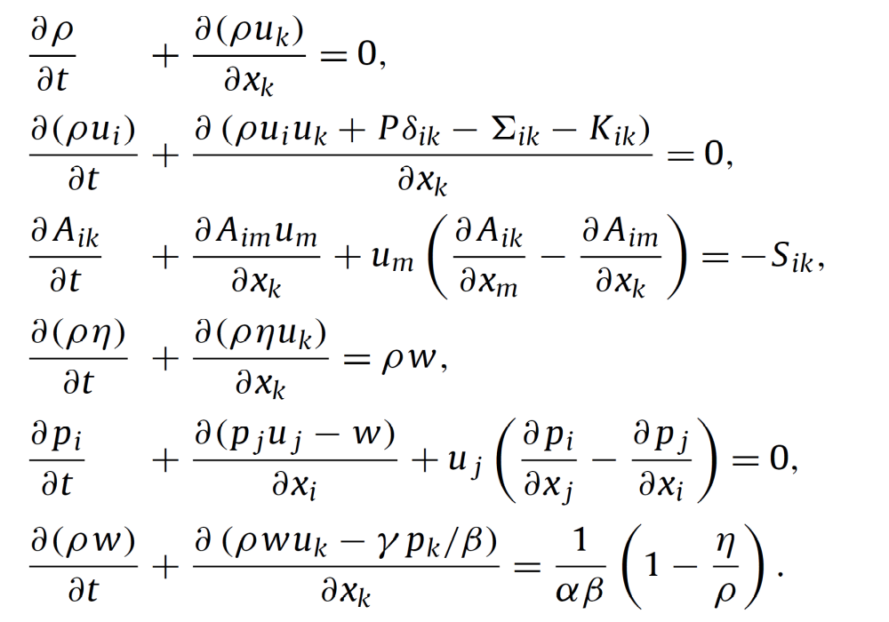
Hyperbolic reformulation of the NSK system
First order hyperbolic reformulation of the Navier-Stokes-Korteweg equations, based on the GPR model, the augmented Lagrangian approach and GLM curl cleaning. As a special feature, it allows to hyperbolize even nonconvex equations of state (all eigenvalues are real for β sufficiently small)!

Slide 18
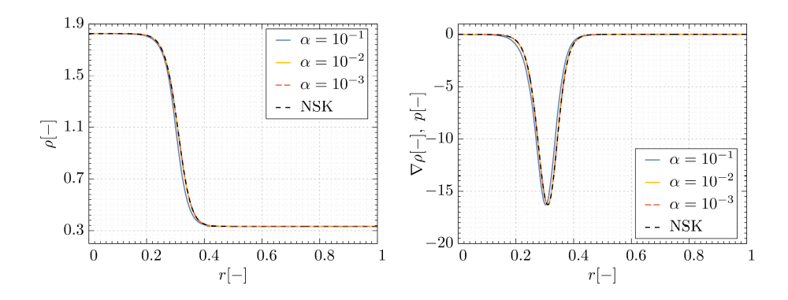
Hyperbolic reformulation of the NSK system
Travelling wave solution

Slide 19
Hyperbolic reformulation of the NSK system
Ostwald ripening in 1D

Slide 20
Hyperbolic reformulation of the NSK system
Ostwald ripening in 2D (density evolution)

Slide 21
Hyperbolic reformulation of the NSK system
Ostwald ripening in 2D (evolution of the gradient field)

Slide 22
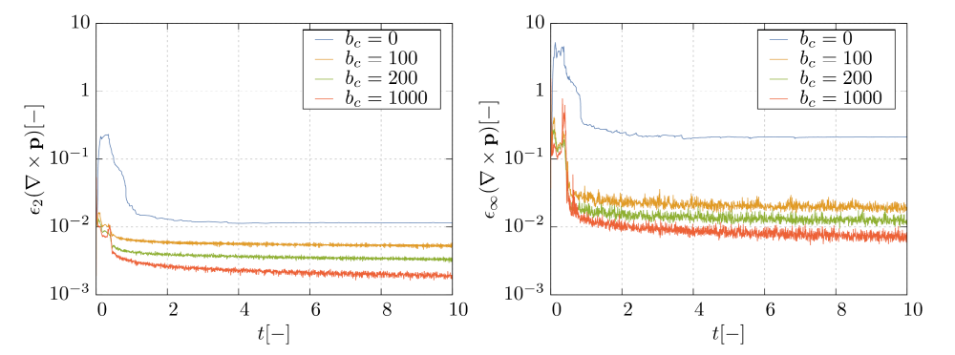
Hyperbolic reformulation of the NSK system
Ostwald ripening in 2D (time evolution of the curl errors)

Slide 23





Staggered Cartesian mesh
In our structure-preserving staggered semi-implicit finite volume scheme, we define the quantities on four different staggered mesh locations: in the barycenters, in the vertices, on the x-edges and on the y-edges of the main grid.
We also use simple central interpolations of all quantities from one mesh to another.
The staggered mesh is a fundamental ingredient for the definition of compatible discrete curl and grad operators needed for our exactly curl-free scheme. It is also important to get a stable and symmetric positive definite discretization of the pressure system

Slide 24
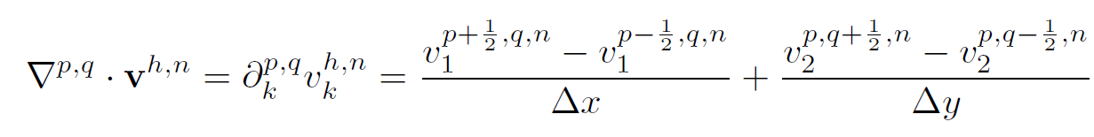


Compatible div, grad and curl operators
The first discrete divergence on a control volume is naturally defined using the edge-based staggered quantities (discrete form of the Gauss theorem):

Slide 25
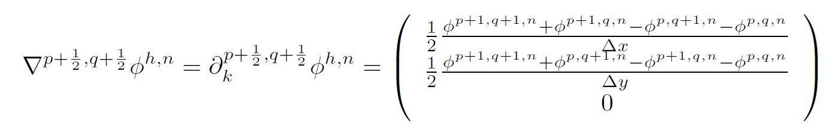




Compatible div, grad and curl operators
The discrete gradient on a vertex is naturally defined using the barycenter quantities (discrete form of the Gauss theorem for tensors):

Slide 26
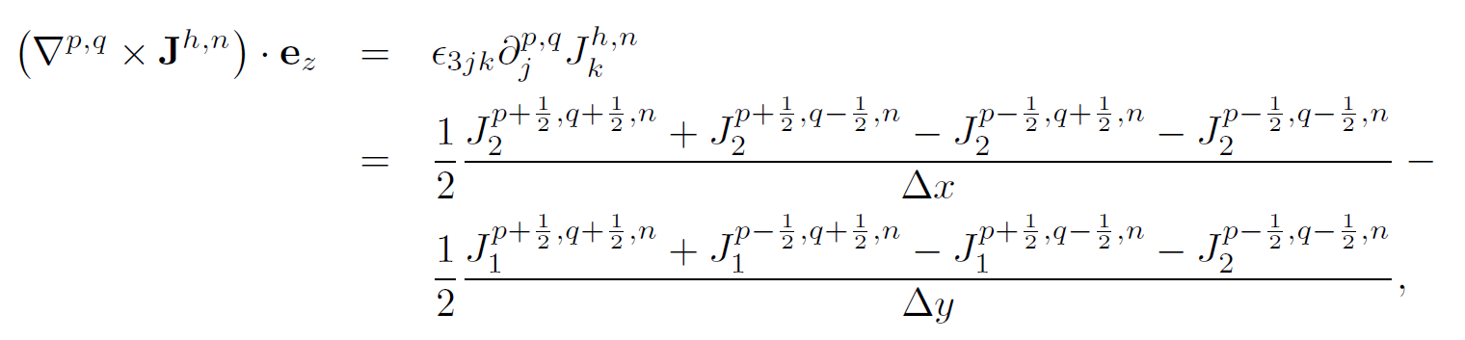




Compatible div, grad and curl operators
The discrete curl on a control volume is naturally defined using the vertex-based staggered quantities (discrete form of the Stokes theorem):

Slide 27

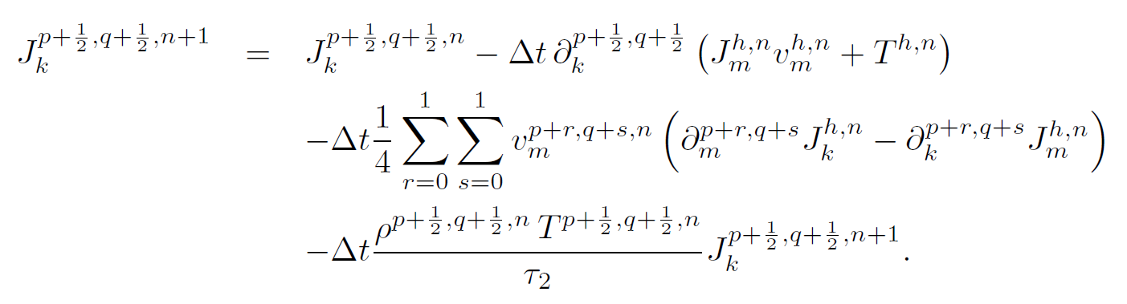
Discrete curl - grad
Combining the previous discrete grad and curl operators, it is then easy to prove that for
an arbitrary discrete scalar field defined in the barycenter of the main grid one has
which is the discrete curl-grad compatibility. Using the previous curl and grad operators, the discretized J equation then reads
If the field J was initially curl-free, it will remain curl-free for all times,
if the source term vanishes (τ₂ = ∞).

Slide 28
Results – Oscillating droplet
Exactly curl-free scheme applied to the hyperbolic surface tension model of Gavrilyuk et al. Comparison with the original weakly hyperbolic system solved by a general purpose scheme, the GLM curl cleaning approach and the exactly curl-free scheme (applied to the original model)

Slide 29
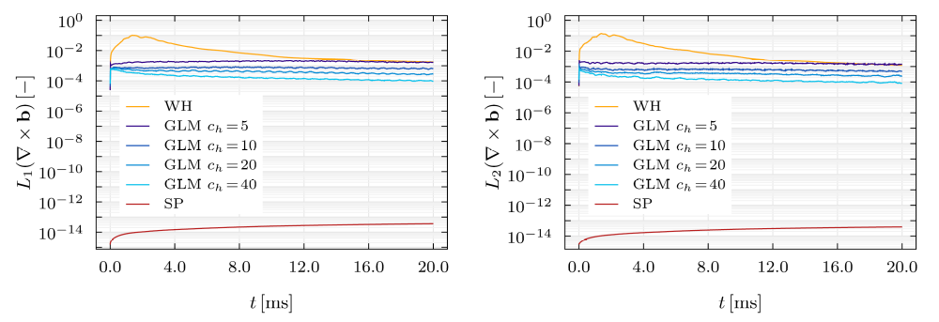
Results – Oscillating droplet
Exactly curl-free scheme applied to the hyperbolic surface tension model of Gavrilyuk et al. Comparison with the original weakly hyperbolic system solved by a general purpose scheme, the GLM curl cleaning approach and the exactly curl-free scheme (applied to the original model)

Slide 30
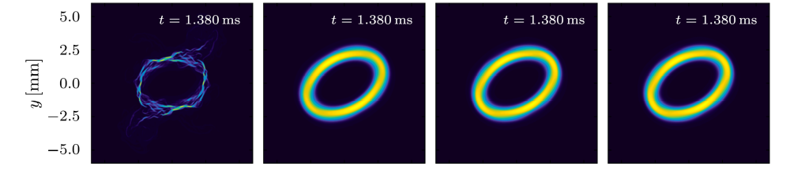
Results – Oscillating droplet

Slide 31
Results – Binary droplet collision

Slide 32
Results – Multiphase Rayleigh-Taylor instability

Slide 33
Results – Multiphase Rayleigh-Taylor instability

Slide 34
Results – Stationary bubble in 2D
Exactly curl-free scheme applied to the hyperbolic NSK model

Slide 35
Results – Stationary bubble in 2D
Exactly curl-free scheme applied to the hyperbolic NSK model

Slide 36
Results – Stationary bubble in 2D
Exactly curl-free scheme applied to the hyperbolic NSK model

Slide 37
Results – Ostwald ripening in 2D
Exactly curl-free scheme applied to the hyperbolic NSK model

Slide 38



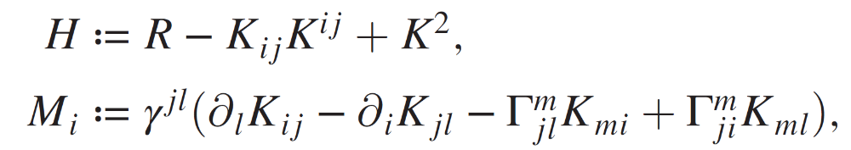

A new frontier for new numerical methods for hyperbolic PDE: The Einstein field equations for dynamic spacetimes
The Z4 Lagrangian for the Einstein-Hilbert action
The resulting field equations where, the Z4 vector takes care of the nonlinear involutions, (Hamiltonian and momentum constraints H, M) via GLM:
Standard 3+1 ADM decomposition of the 4 metric:

Slide 39
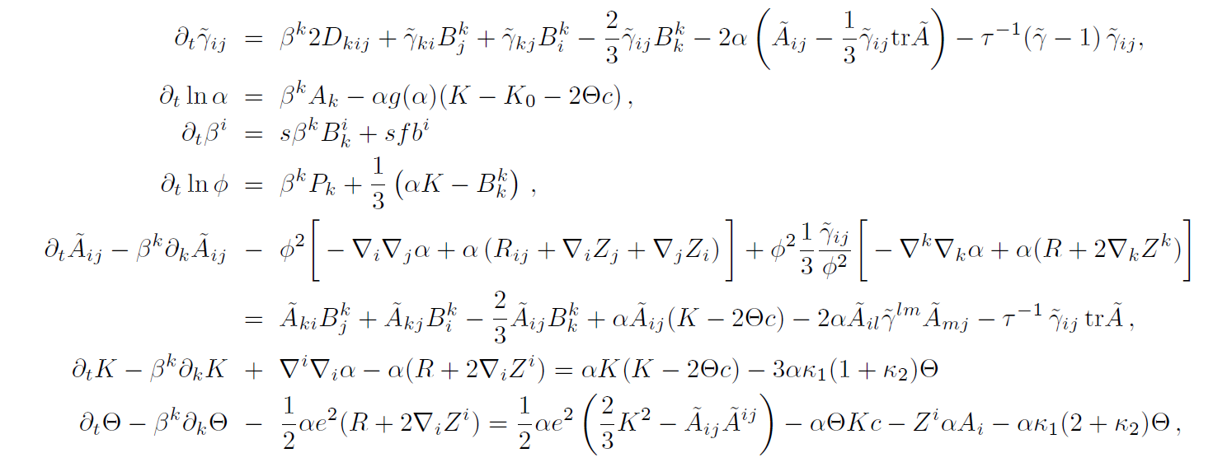
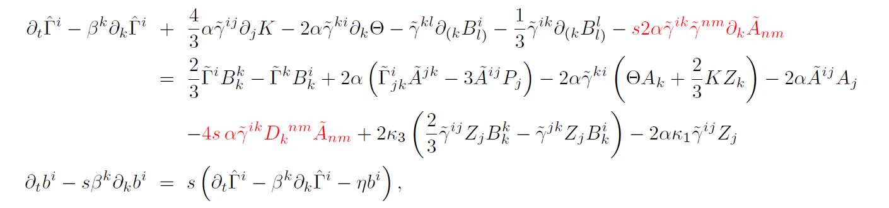
ADER-DG for a novel first order hyperbolic CCZ4 system
The PDE for the 25 primary variables

Slide 40
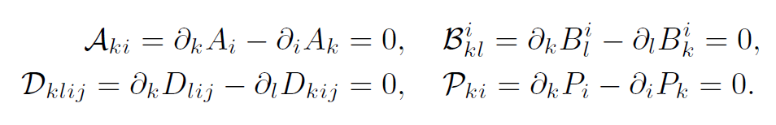



ADER-DG for a novel first order hyperbolic CCZ4 system
Introduction of the following auxiliary quantities...
...leads to the following second order ordering constraints:
Since is trace free, we have an additional involution constraint (!)
and the unit determinant of the conformal metric implies the algebraic constraint

Slide 41
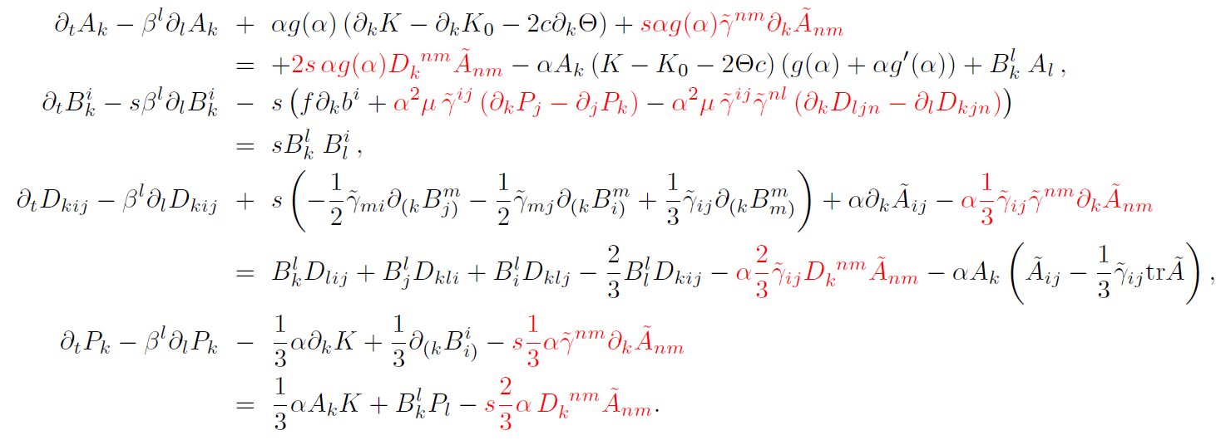
ADER-DG for a novel first order hyperbolic CCZ4 system
The PDE for the 33 auxiliary variables needed to get a first order system.
In total: 58 evolution quantities for the vacuum Einstein equations.
Note: our FO-CCZ4 system is deliberately written in a fully
non-conservative form and is thus solved with the path-conservative
approach introduced by Parés and Castro in 2006.
For standard gauges, we can compute the entire eigenstructure of the system analytically, thus proving strong hyperbolicity of the system.

Slide 42
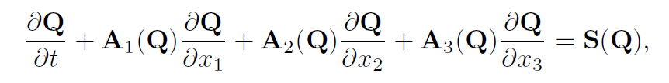
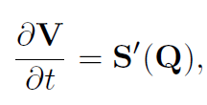
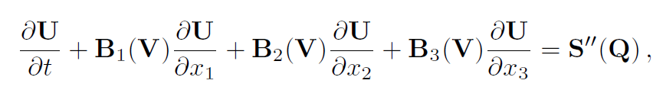



ADER-DG for a novel first order hyperbolic CCZ4 system
Our non-conservative FO-CCZ4 system has a very particular split structure:
(ODE-type sub-system for the 4-metric)
Key feature: all characteristic fields of our new
FO-CCZ4 system are linearly degenerate,
hence no shocks can be generated!
(split of the state vector Q)
(V defines the 4-metric)
(U are the remaining dynamic quantities)

Slide 43
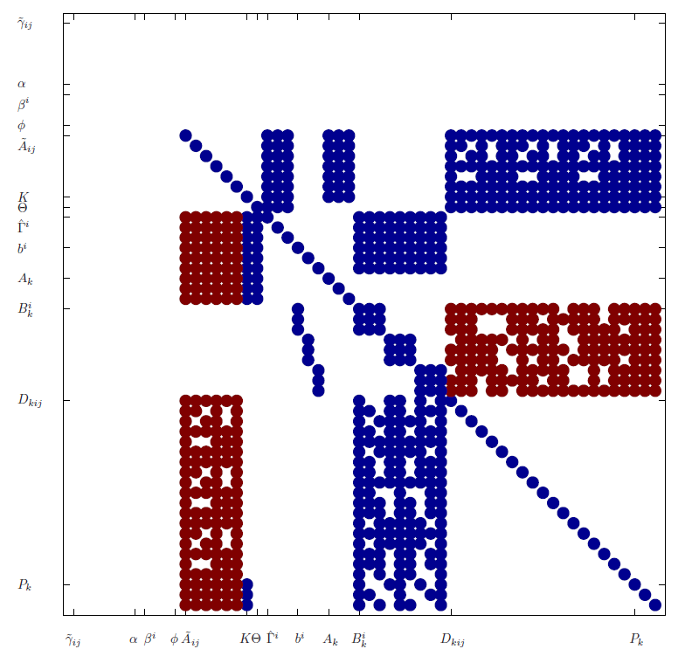
ADER-DG for a novel first order hyperbolic CCZ4 system
Key idea: approximate symmetrization via Godunov-Powell-type terms.
Sparsity structure of the original system matrix (blue) plus the
additional constraints (blue & red)

Slide 44
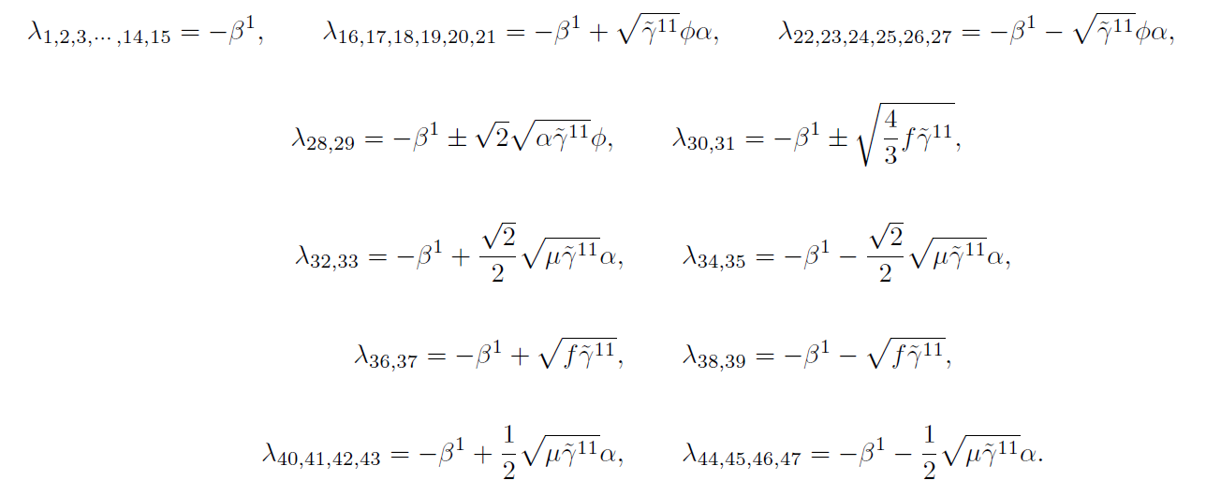
ADER-DG for a novel first order hyperbolic CCZ4 system
The 47 eigenvalues of the PDE system in the dynamic variables

Slide 45
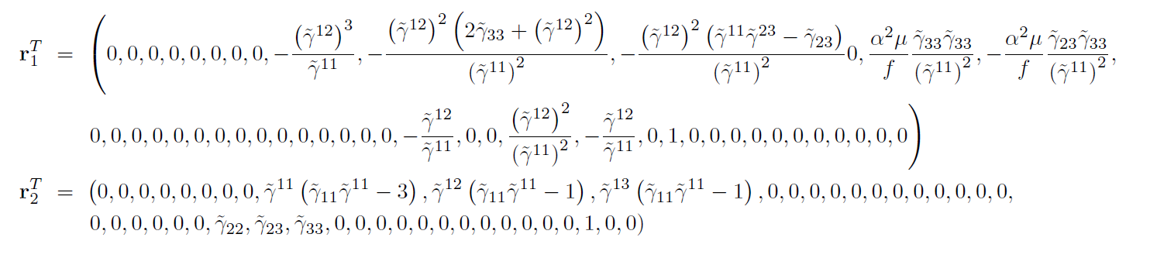
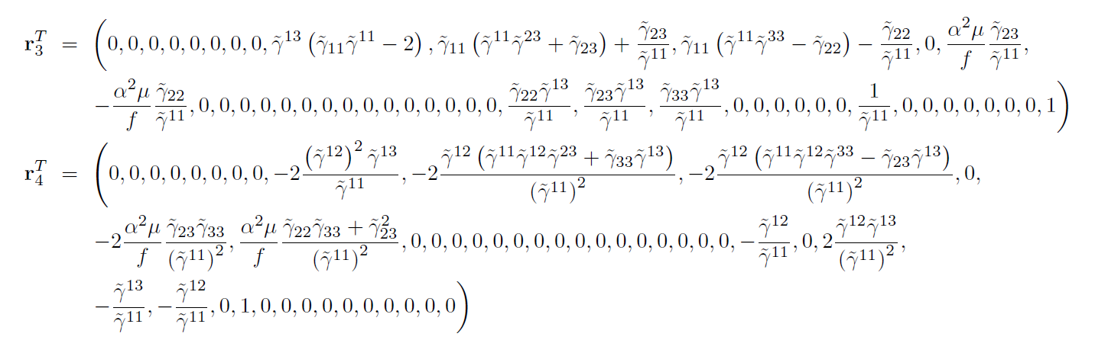
ADER-DG for a novel first order hyperbolic CCZ4 system
Some of the 47 linearly independent right eigenvectors of the
PDE system in the dynamic variables

Slide 46
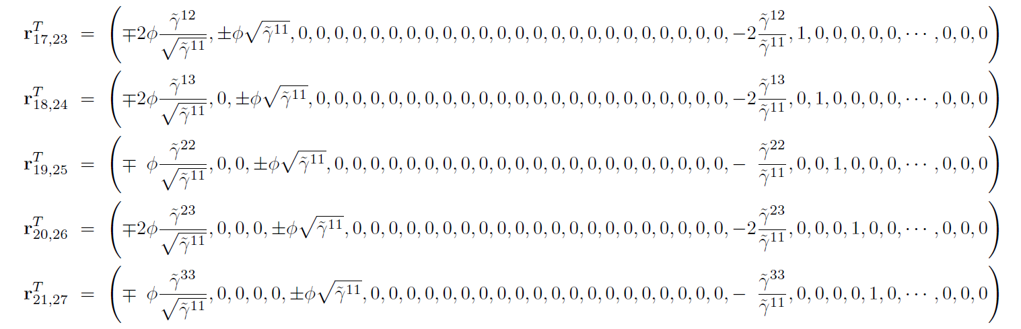
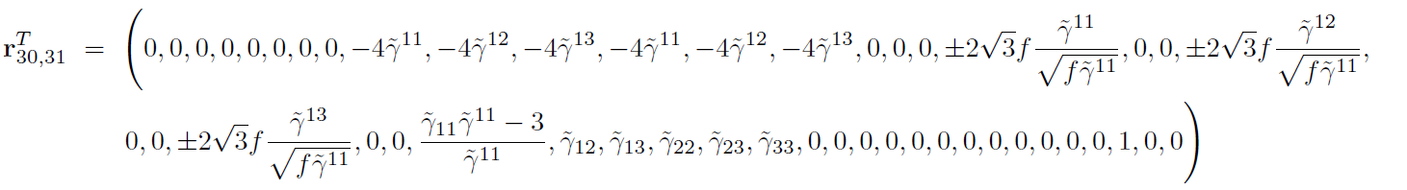
ADER-DG for a novel first order hyperbolic CCZ4 system
Some of the 47 linearly independent right eigenvectors of the
PDE system in the dynamic variables

Slide 47
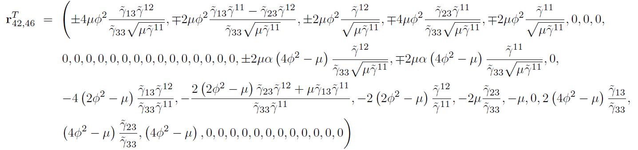
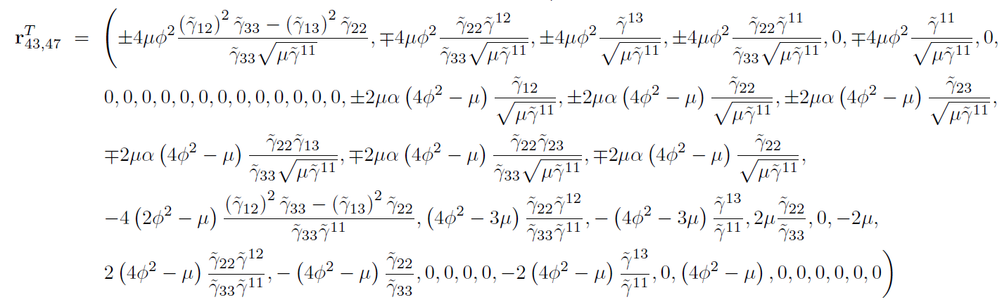
ADER-DG for a novel first order hyperbolic CCZ4 system
Some of the 47 linearly independent right eigenvectors of the
PDE system in the dynamic variables

Slide 48
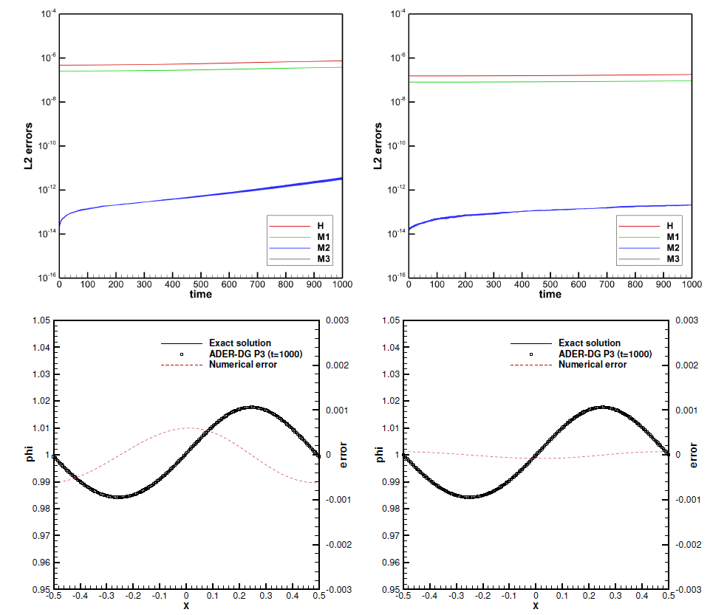
Gauge wave testcase
Amplitude parameter A=0.1. Cleaning speed e=1 (left) and e=2 (right)

Slide 49
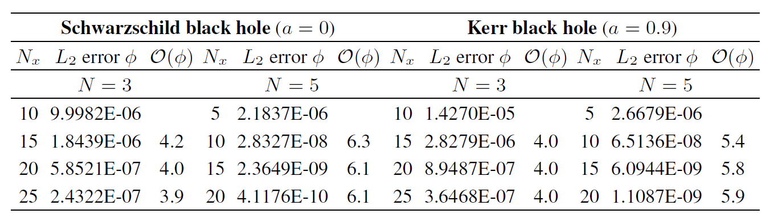
Convergence rates for black hole spacetimes
Convergence tests on Schwarzschild and kerr black hold space times carried out in three space dimensions, using 3D Cartesian Kerr-Schild coordinates.

Slide 50
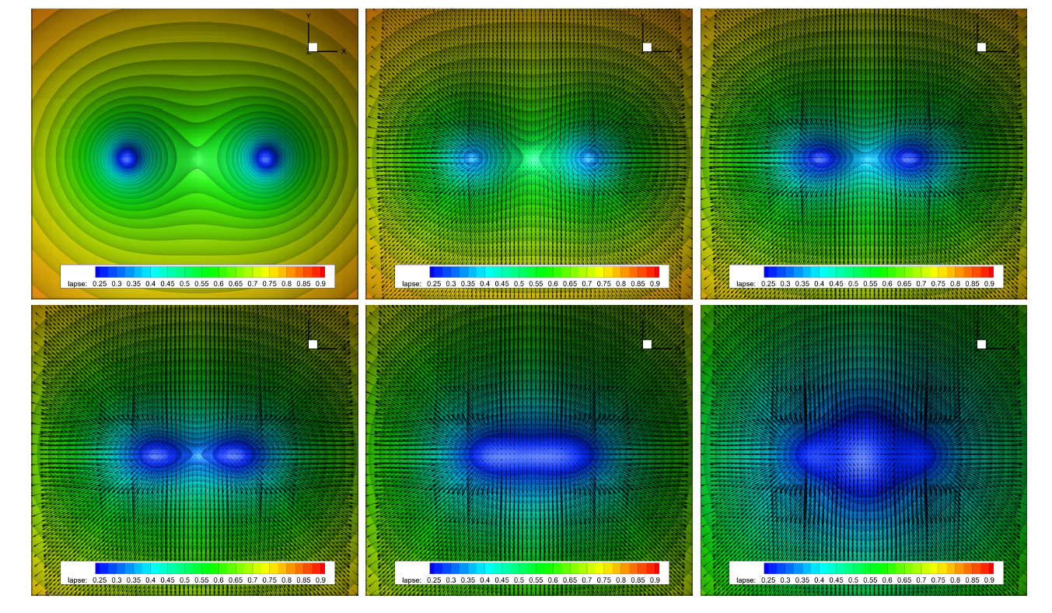
Preliminary results for moving punctures

Slide 51
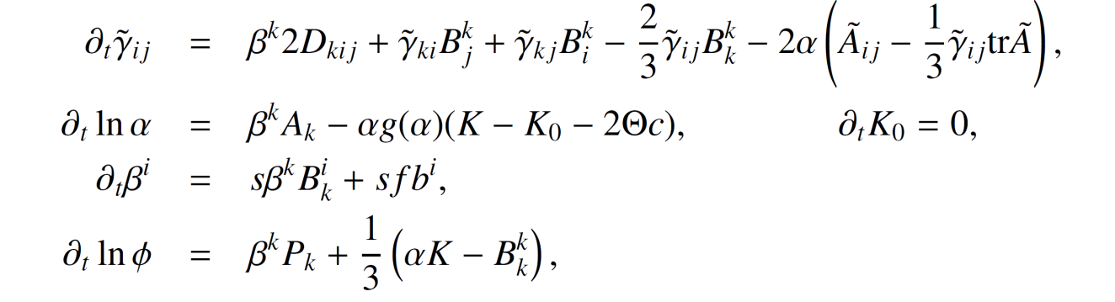
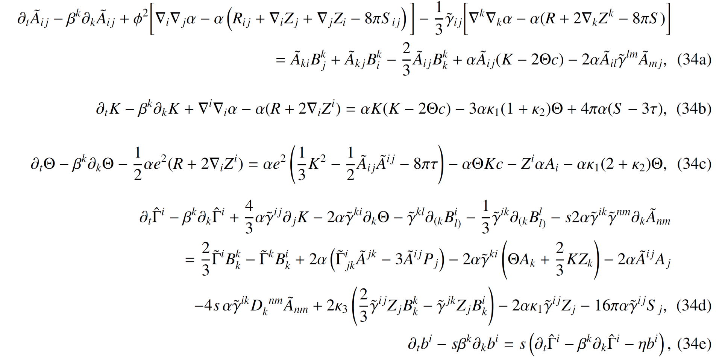
FO-CCZ4 + GRMHD with GLM curl cleaning

Slide 52
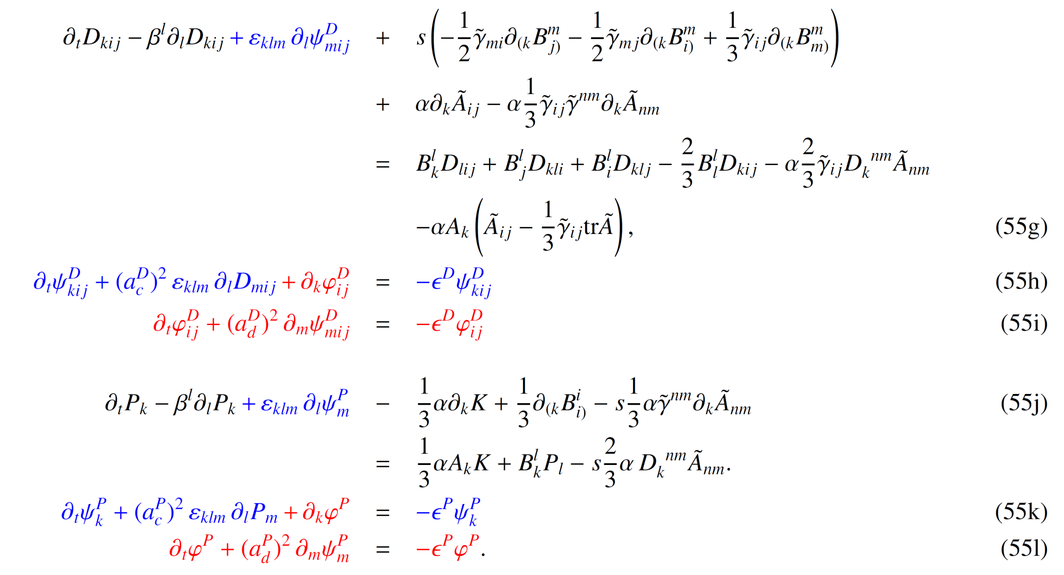
FO-CCZ4 + GRMHD with GLM curl cleaning
The augmented GLM curl cleaning system for the auxiliary variables

Slide 53


FO-CCZ4 + GRMHD with GLM curl cleaning
Matter evolution equations

Slide 54

FO-CCZ4 + GRMHD with GLM curl cleaning
Robust stability test.
Dashed lines are without GLM curl cleaning, continuous lines are with GLM curl cleaning.
Improvements by up to 4 orders of magnitude.
coarse mesh
fine mesh

Slide 55

FO-CCZ4 + GRMHD with GLM curl cleaning
Long-time evolution of a neutron star in anti-Cowling approximation.
Dashed lines are without GLM curl cleaning, continuous lines are with GLM curl cleaning

Slide 56

FO-CCZ4 + GRMHD with GLM curl cleaning
Long-time evolution of a neutron star in anti-Cowling approximation.
Comparison of the numerical solution with the exact one at time t=1000.

Slide 57

FO-CCZ4 + GRMHD with GLM curl cleaning
Long-time evolution of a neutron star in anti-Cowling approximation.
Comparison of the numerical solution with the exact one at time t=1000.

Slide 58

FO-CCZ4 + GRMHD with GLM curl cleaning
Long-time evolution of a neutron star in anti-Cowling approximation.
Iso-surfaces of the conformal factor at time t=1000.

Slide 59

FO-CCZ4 + GRMHD with GLM curl cleaning
Rotating binary system in anti-Cowling approximation
(externally prescribed matter source terms). Contour colors for the trace of the
extrinsic curvature at t=175.

Slide 60

FO-CCZ4 + GRMHD with GLM curl cleaning
Rotating binary system in anti-Cowling approximation
constraint evolution with standard FO-CCZ4 (dashed) and with GLM cleaning (solid lines)

Slide 61
Conclusions and Outlook
GLM curl cleaning for Newtonian and general relativistic continuum physics
Easy to implement in existing hyperbolic codes. No special grid staggering or changes in the numerical scheme are needed
Allows to restore strong hyperbolicity
Thermodynamically compatible GLM divergence and curl cleaning now available (many thanks Sergey!!)
More efficient and conservative compared to the Godunov-Powell method
Extension to high order accurate exactly curl-free schemes using FEEC and high order staggered DG schemes
Coupling with provably thermodynamically compatible schemes
Combination with exactly well-balanced schemes

Slide 62
References
[R1] M. Dumbser et al. Conformal and covariant Z4 formulation of the Einstein equations: strongly
hyperbolic first-order reduction and solution with discontinuous Galerkin schemes.
Physical Review D, 97 084053 , 2018
[R2] M. Dumbser, F. Fambri, E. Gaburro, A. Reinarz. On GLM curl cleaning for a first order reduction
of the CCZ4 formulation of the Einstein field equations. Journal of Computational Physics,
404:109088, 2020
[R3] S. Chiocchetti, I. Peshkov, S. Gavrilyuk and M. Dumbser. High order ADER schemes and GLM
curl cleaning for a first order hyperbolic formulation of compressible flow with surface tension.
Journal of Computational Physics, 426:109898, 2021
[R4] S. Busto et al. On high order ADER discontinuous Galerkin schemes for first order
hyperbolic reformulations of nonlinear dispersive systems. Journal of Scientific Computing,
87:48, 2021
[R5] F. Dhaouadi and M. Dumbser. A first order hyperbolic reformulation of the Navier-Stokes-
Korteweg system based on the GPR model and an augmented Lagrangian approach, Journal of
Computational Physics, 470:111544, 2022
[R6] S. Chiocchetti and M. Dumbser. An exactly curl-free staggered semi-implicit finite volume
scheme for a first order hyperbolic model of viscous two-phase flows with surface tension,
Journal of Scientific Computing, 94:24, 2023
[R7] F. Dhaouadi and M. Dumbser. A structure-preserving finite volume scheme for a hyperbolic
reformulation of the Navier–Stokes–Korteweg equations, Mathematics, 11:876, 2023
.

